Slide 1
Analysis On lead Data For Future Marketing Strategies

Slide 2

CTO Data
Notes:
After carefully looking at the CTO data, there is not enough demographic data regarding the registered (converted) leads to provide meaningful analysis regarding patterns in converted leads demographics
A general summary of the data will be provided

Slide 3
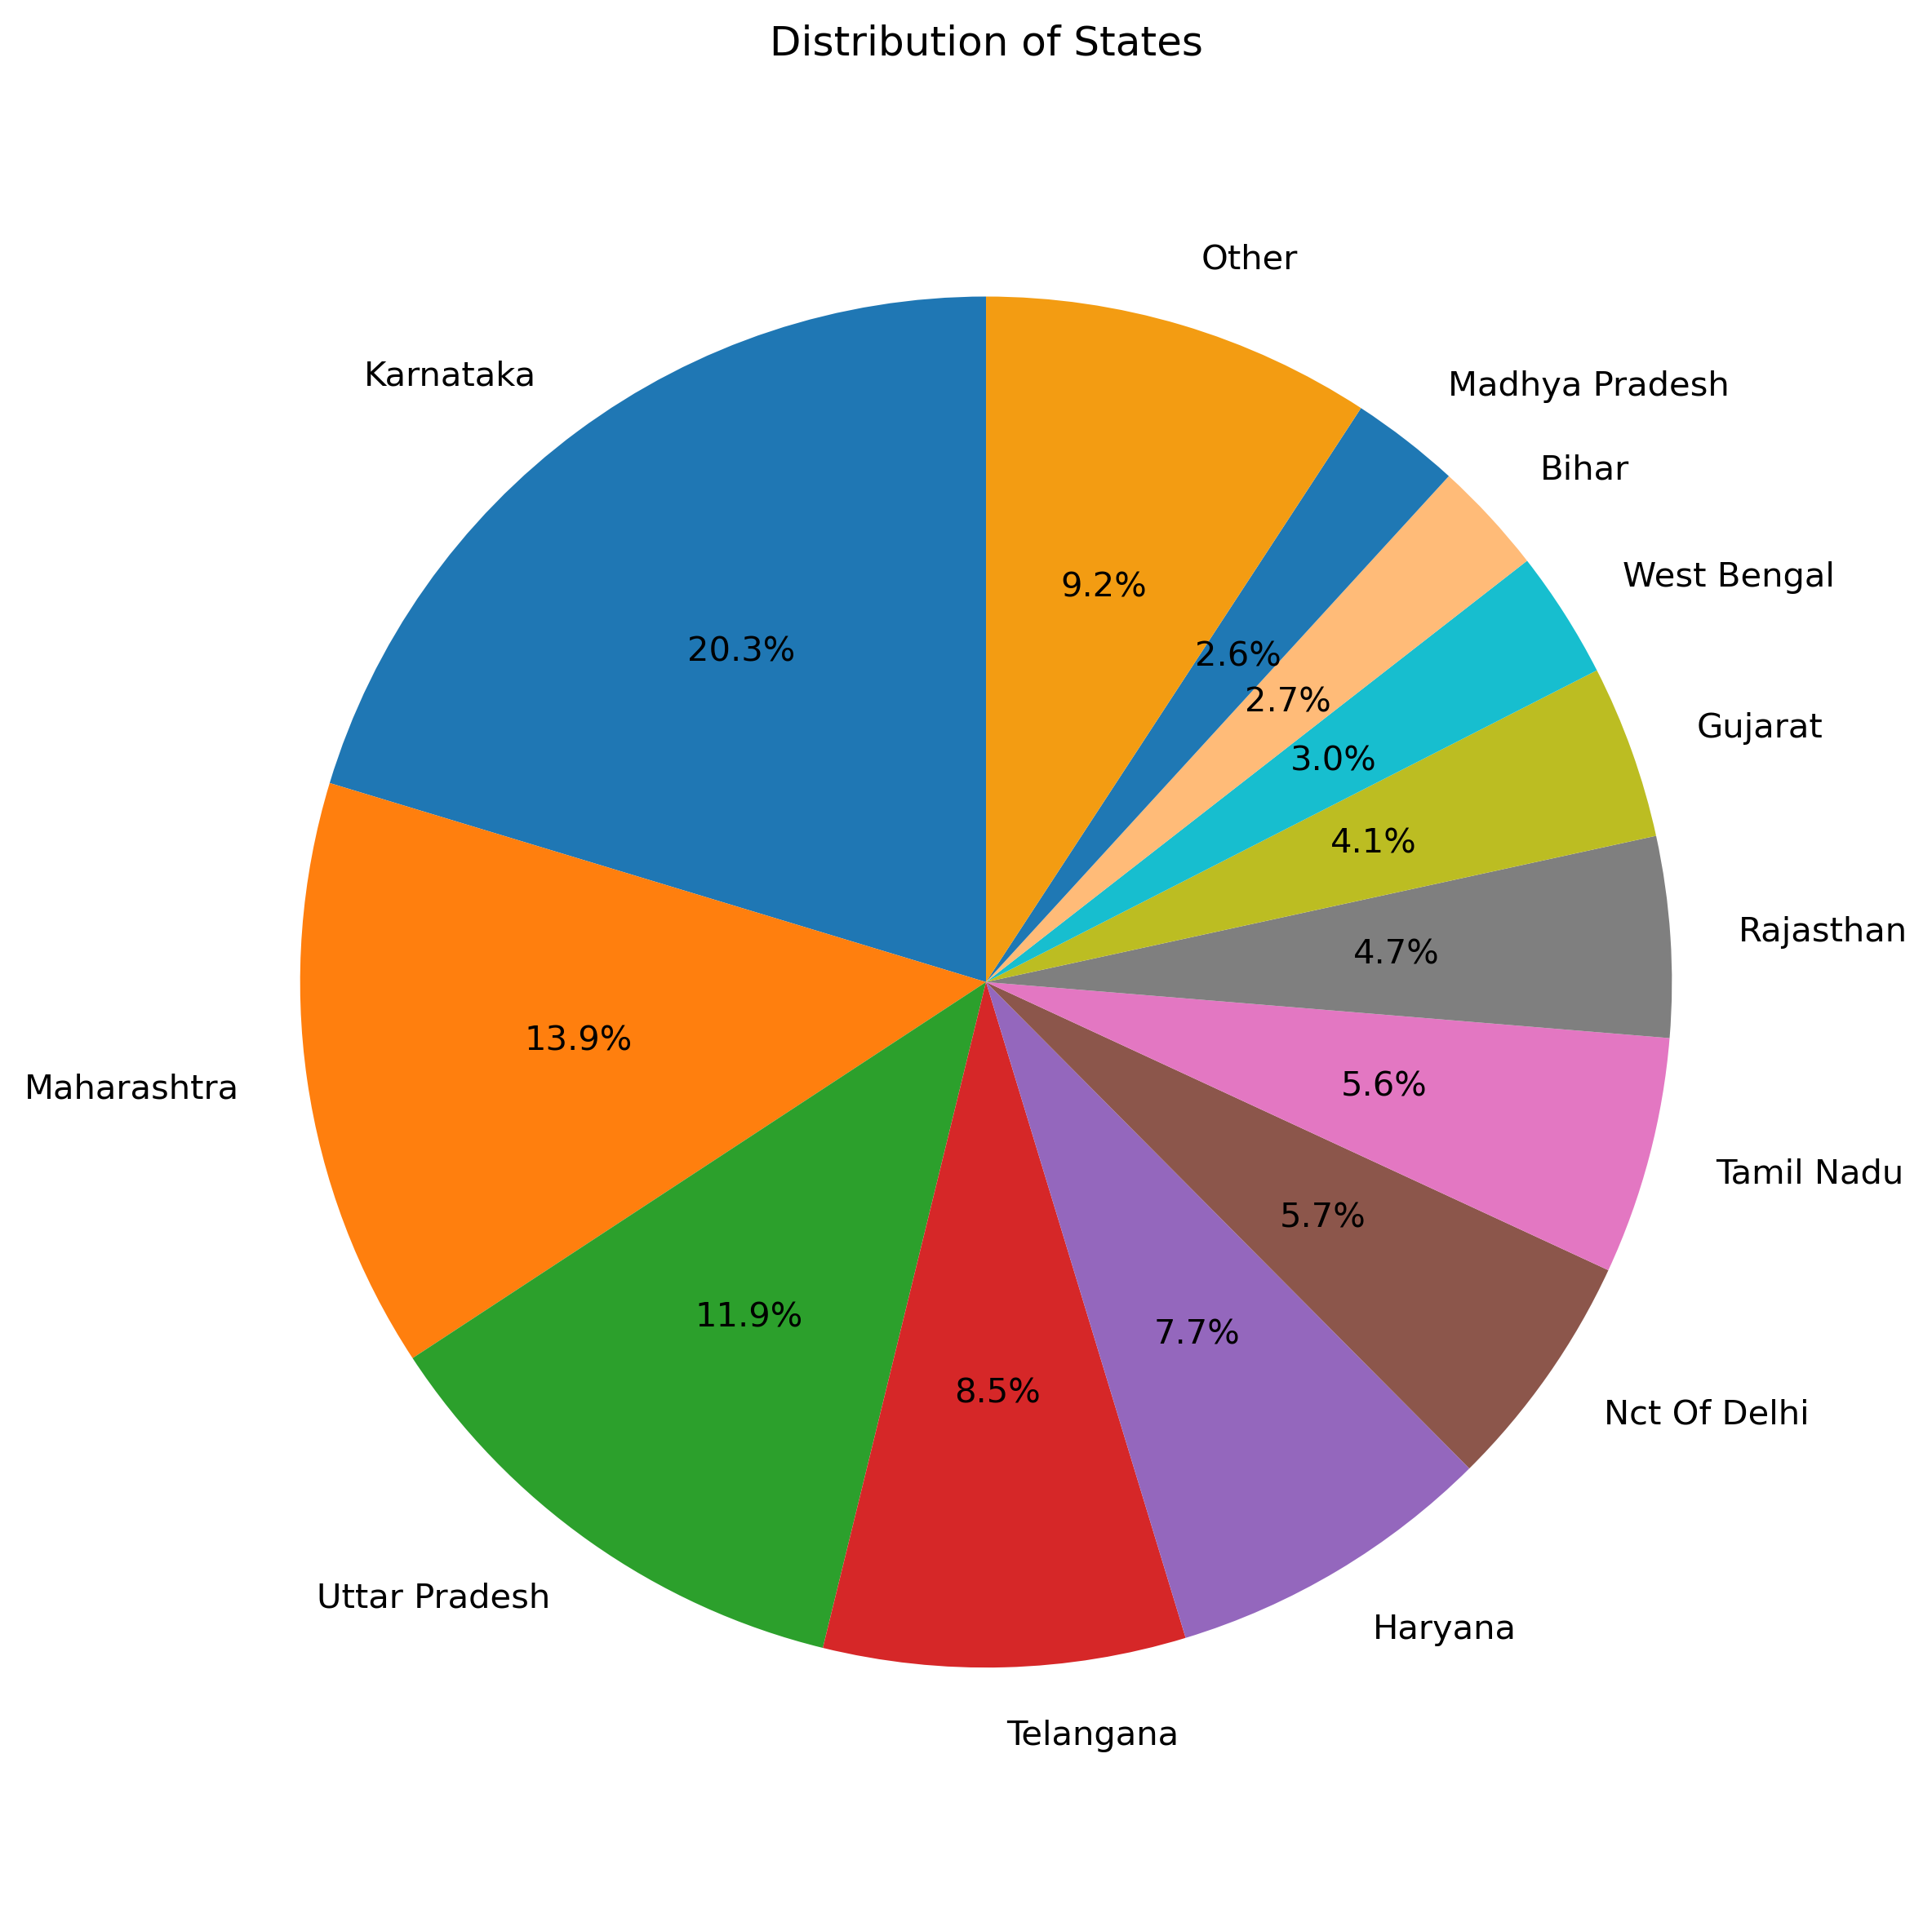
Number Of Entries: 2053
Notes:
- Distribution of state demographics based on the lead entries
- Majority of leads come from the states of Karnataka, Maharashtra, Uttar Pradesh, Telangana, and Haryana

Slide 4
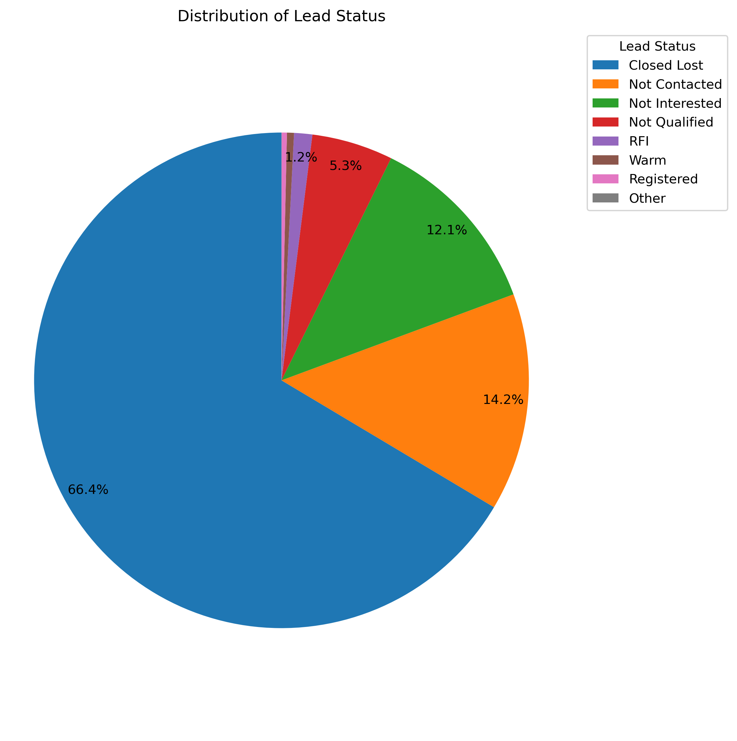
Number Of Entries: 8514
Notes:
Distribution of Lead Statuses amongst entries
Majority of the leads for the CTO course group are considered as “Closed Lost” with 66.4%
Including the not contacted, not interested groups, and not qualified groups, 98% of leads are unconverted with no possibility of being converted in the future
Less than 1% of leads are converted into registered customers

Slide 5
XLRI Data
State, Country, Work Experience, and Job Demographics
Notes:
- XLRI data has much more meaningful insights

Slide 6
State Data and Demographics
Notes:
- State Data and Demographics

Slide 7
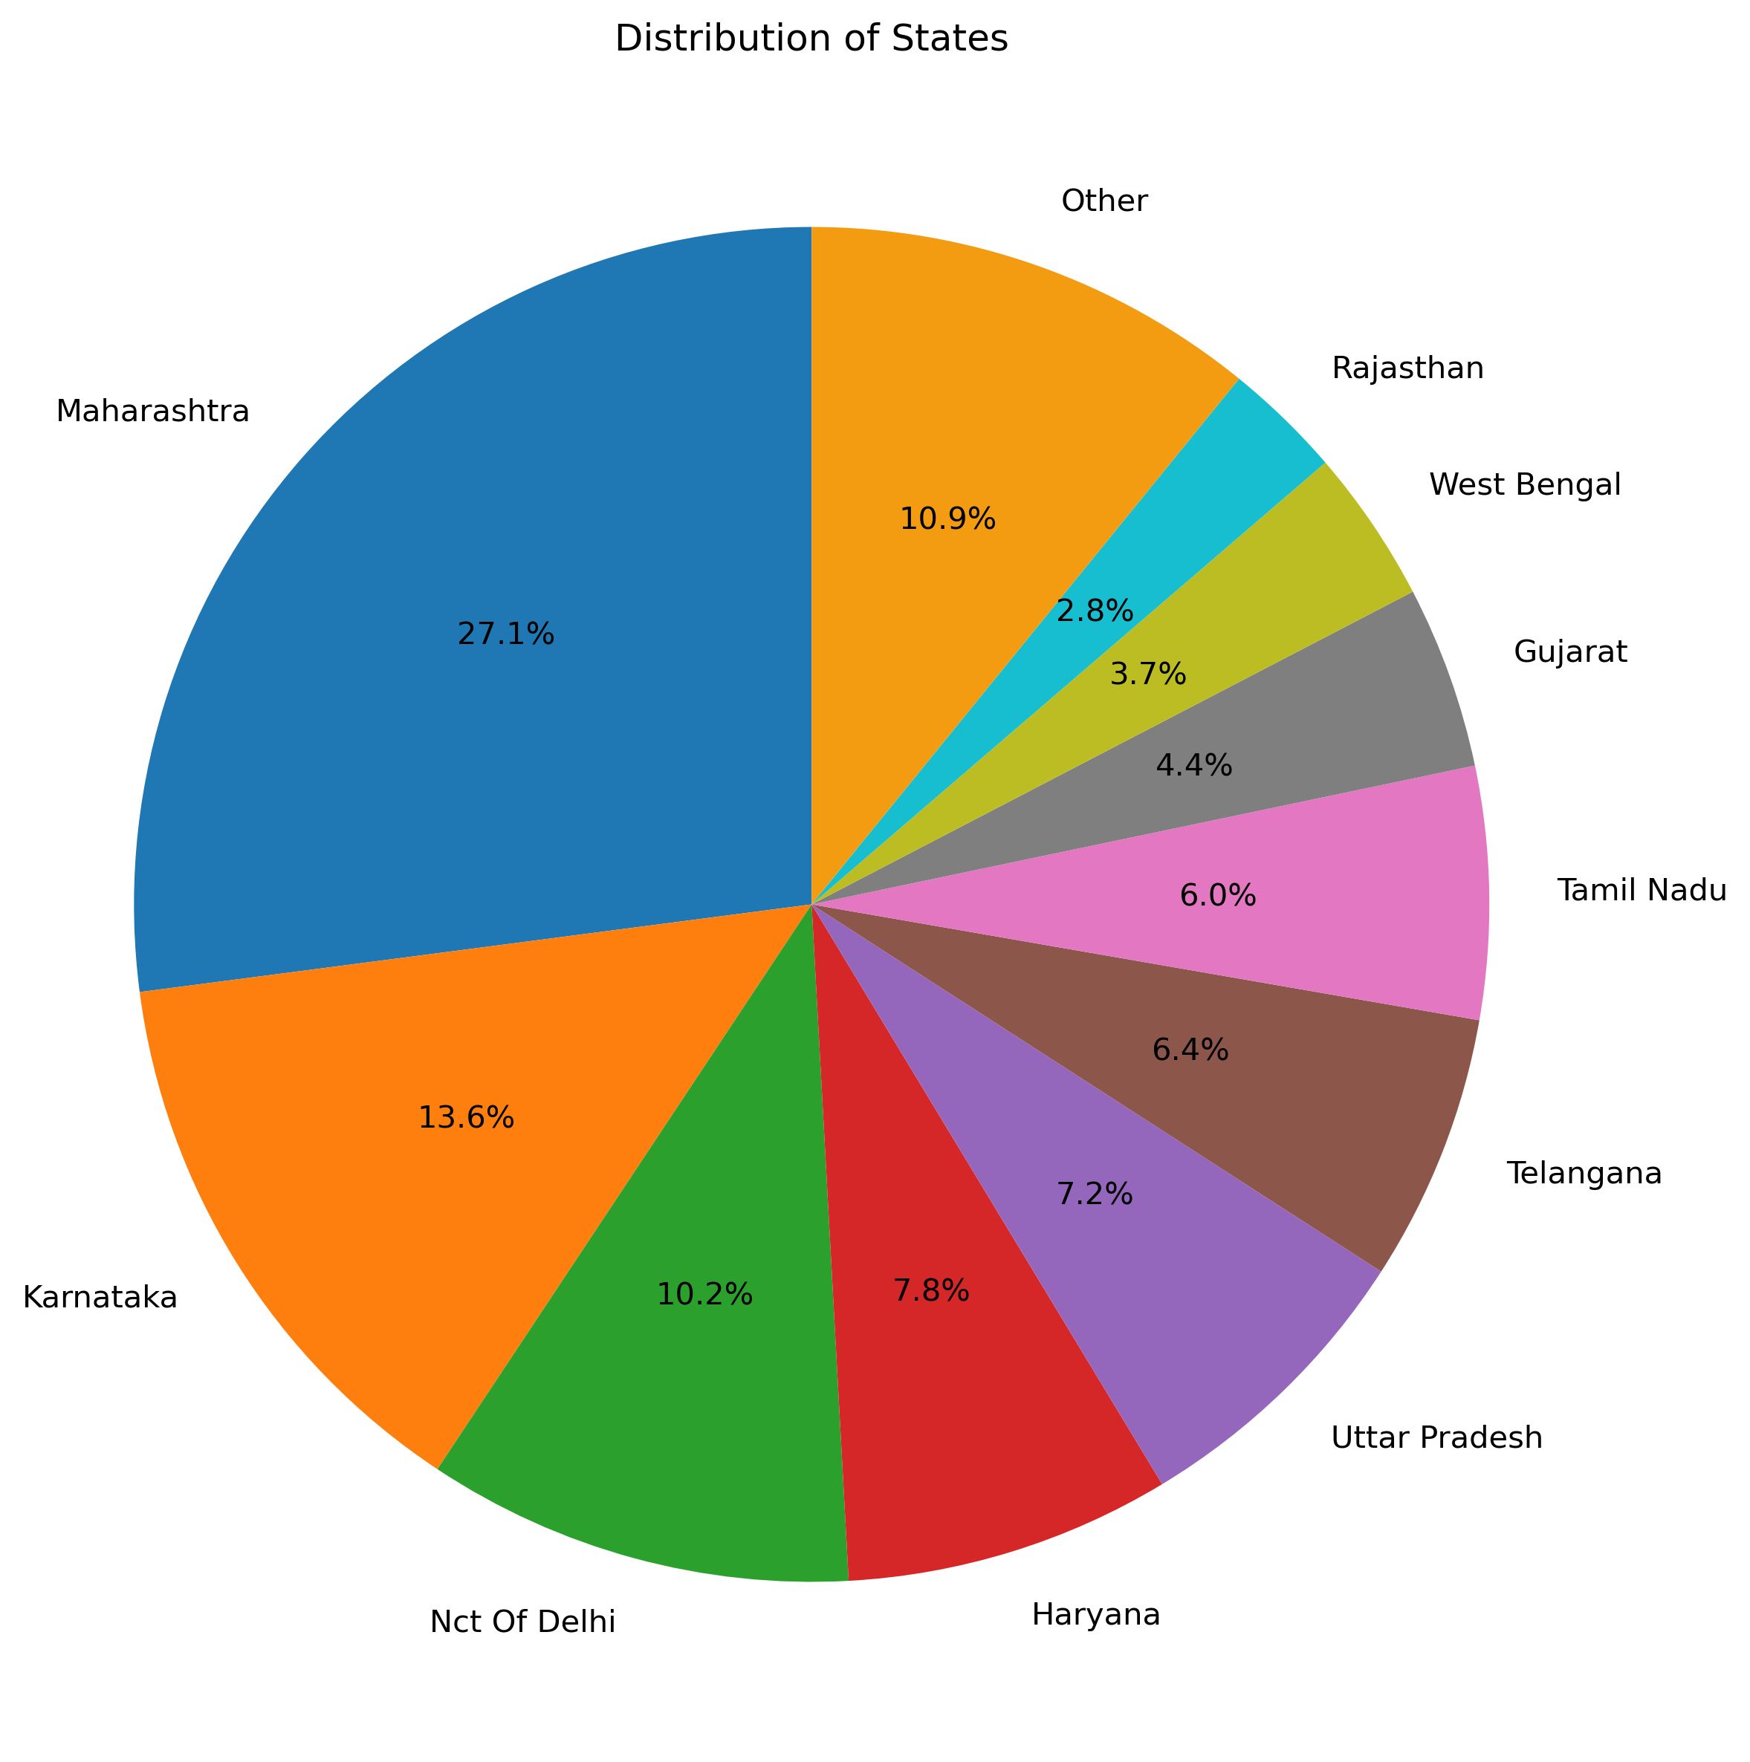
Number Of Entries: 9995
Notes:
- Distribution of state demographics based on the lead entries
- Majority of leads come from Maharashtra, Karnataka, Delhi, Haryana, Uttar Pradesh, Telangana, and Tamil Nadu

Slide 8
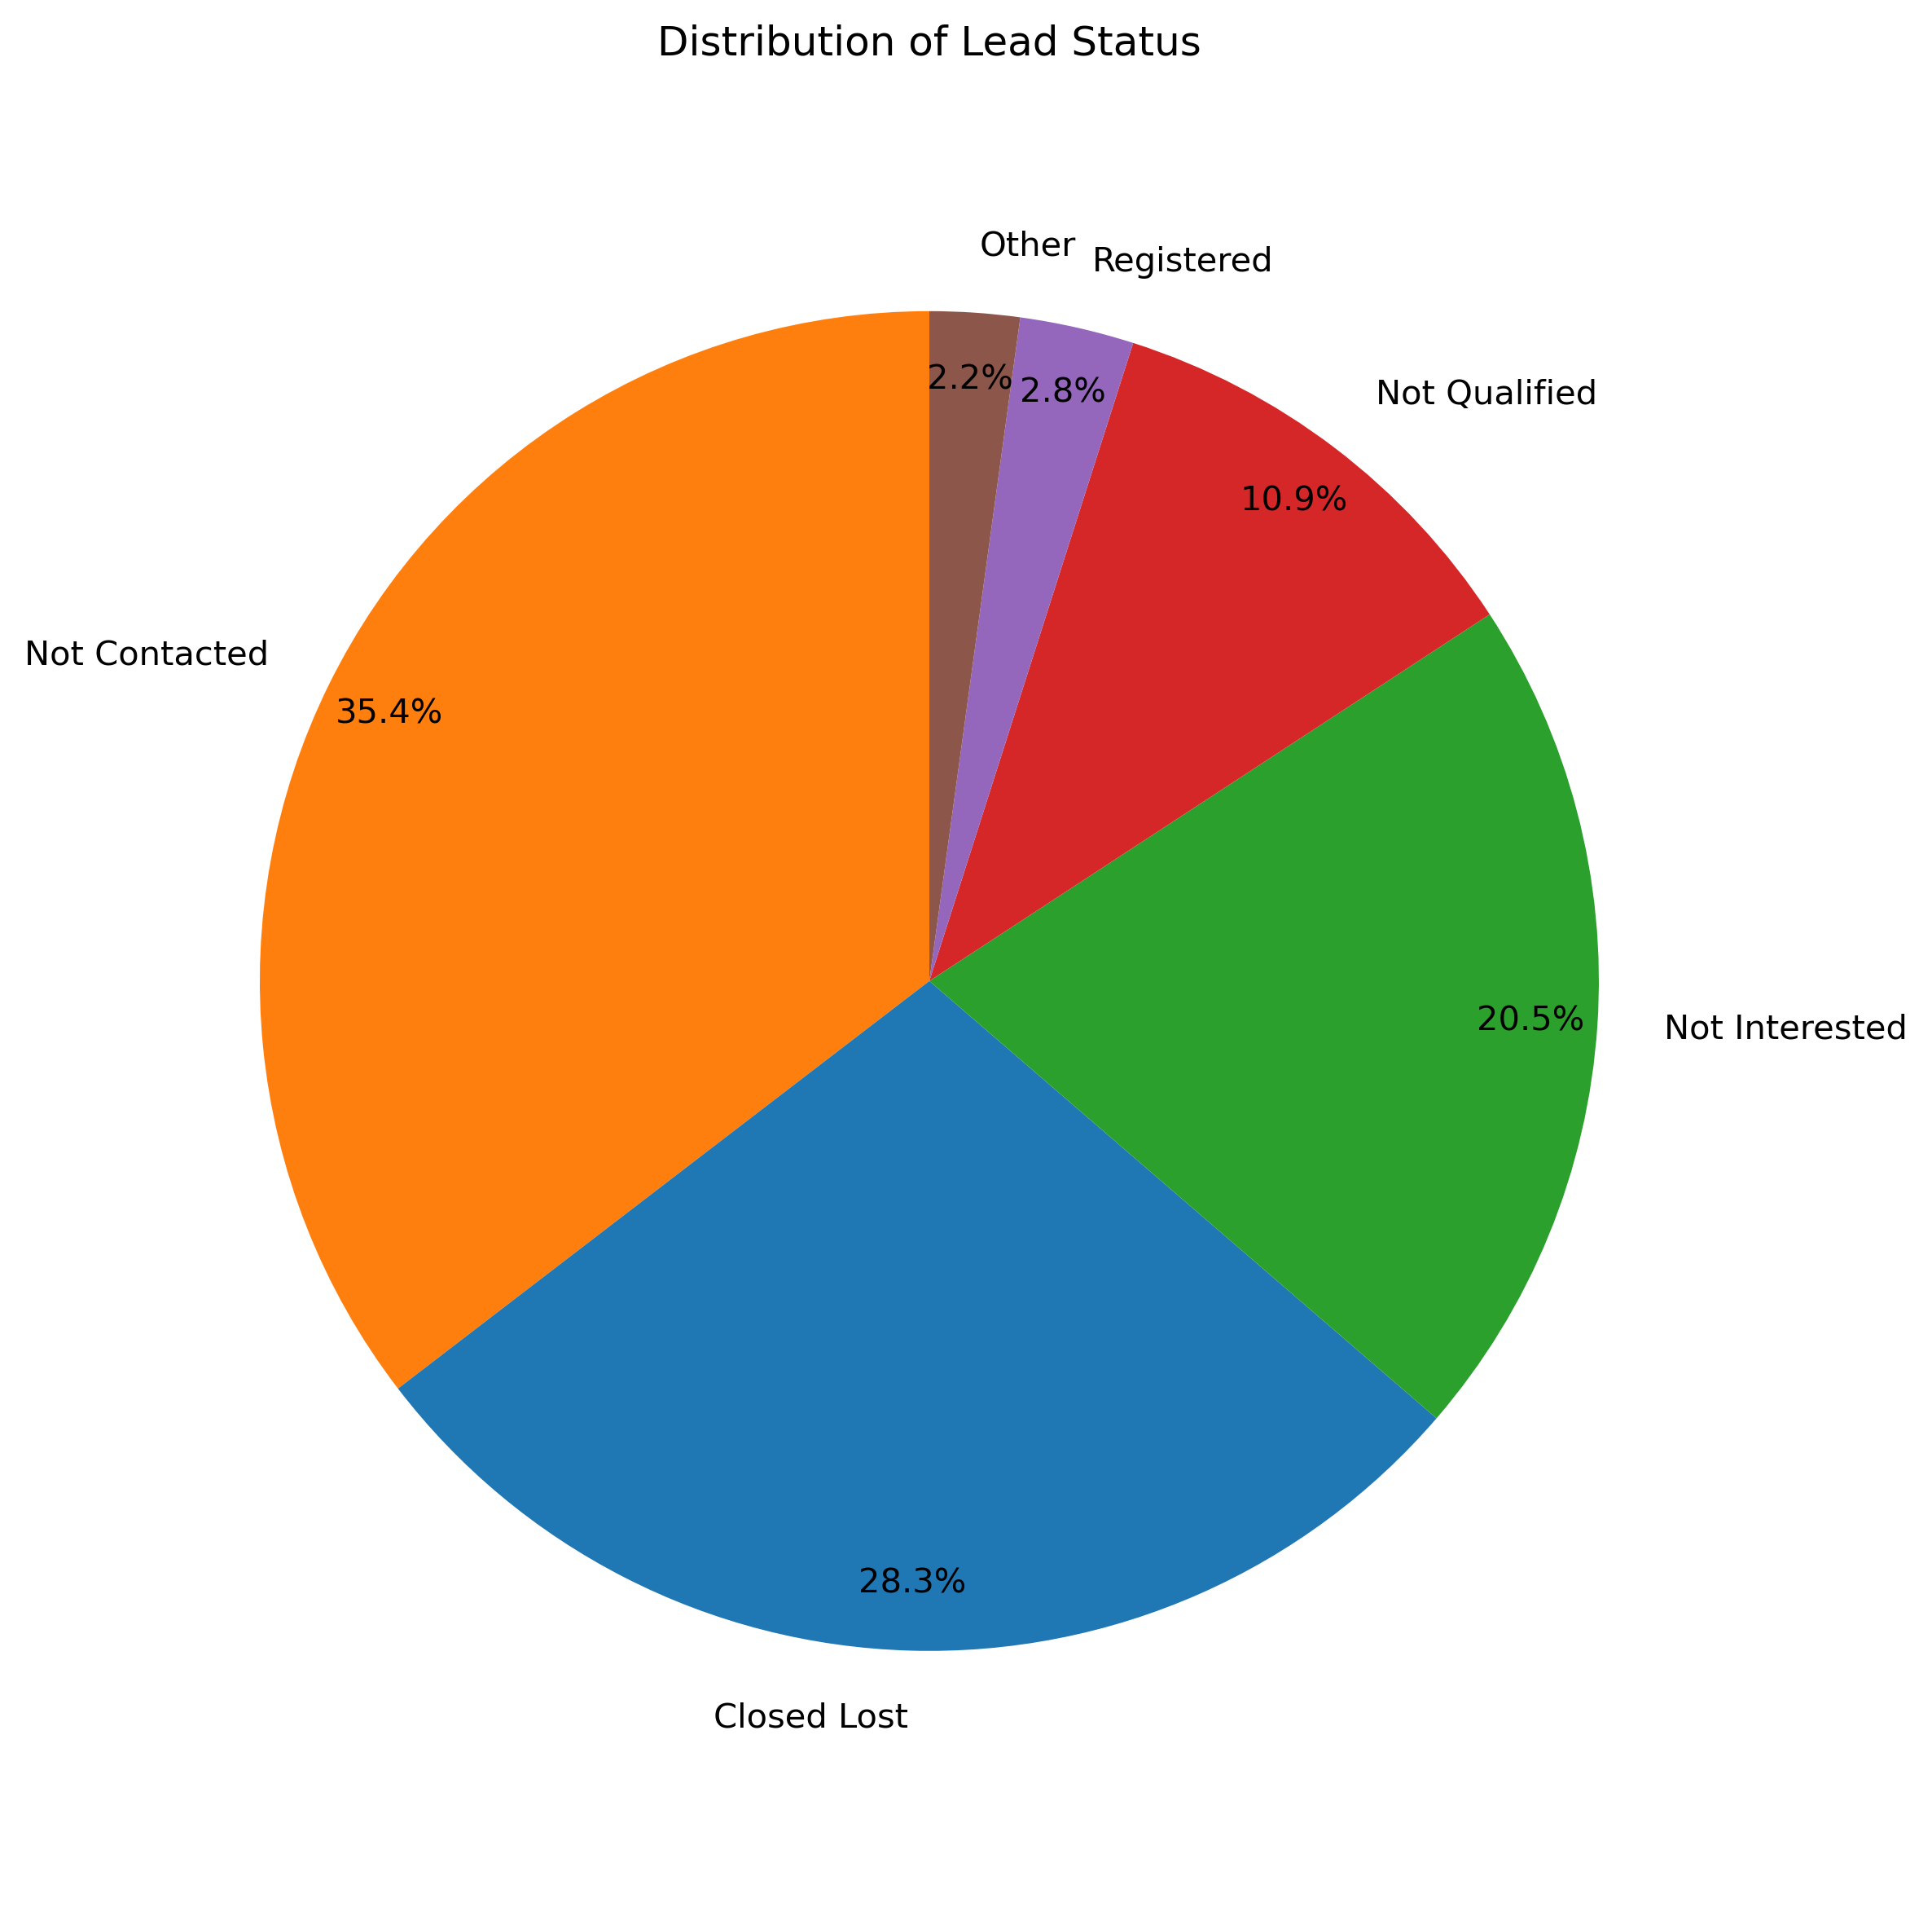
Number Of Entries: 11136
Notes:
- Distribution of Lead Statuses amongst entries
- Majority of leads are considered ”Not Contacted”
95.1% of leads are considered unconverted with a no future possibility of being converted
2.8% of leads are converted being considered “Registered”, this will be used as somewhat of a baseline for determining the most successful states

Slide 9
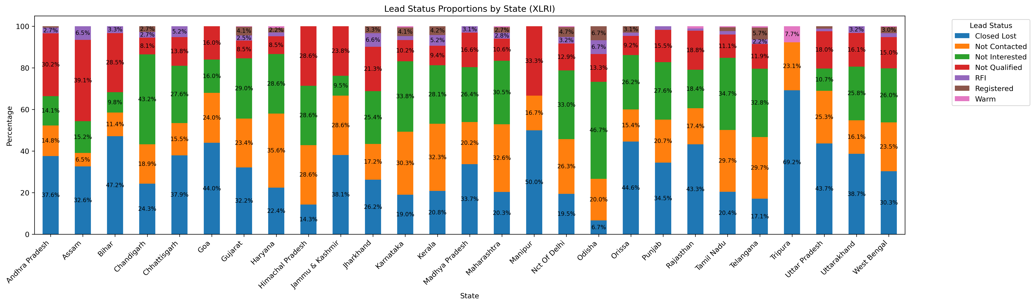
Notes:
General summary of lead status separated by state, only considering states with 5 or more entries
Graph is standardized by percentage of lead statuses per state
States with any registered entries are Chandigarh, Gujarat, Haryana, Jharkhand, Karnataka, Kerala, Maharashtra, Nct Of Delhi, Odisha, Orissa, Tamil Nadu, Telangana, Uttar Pradesh, and West Bangal

Slide 10
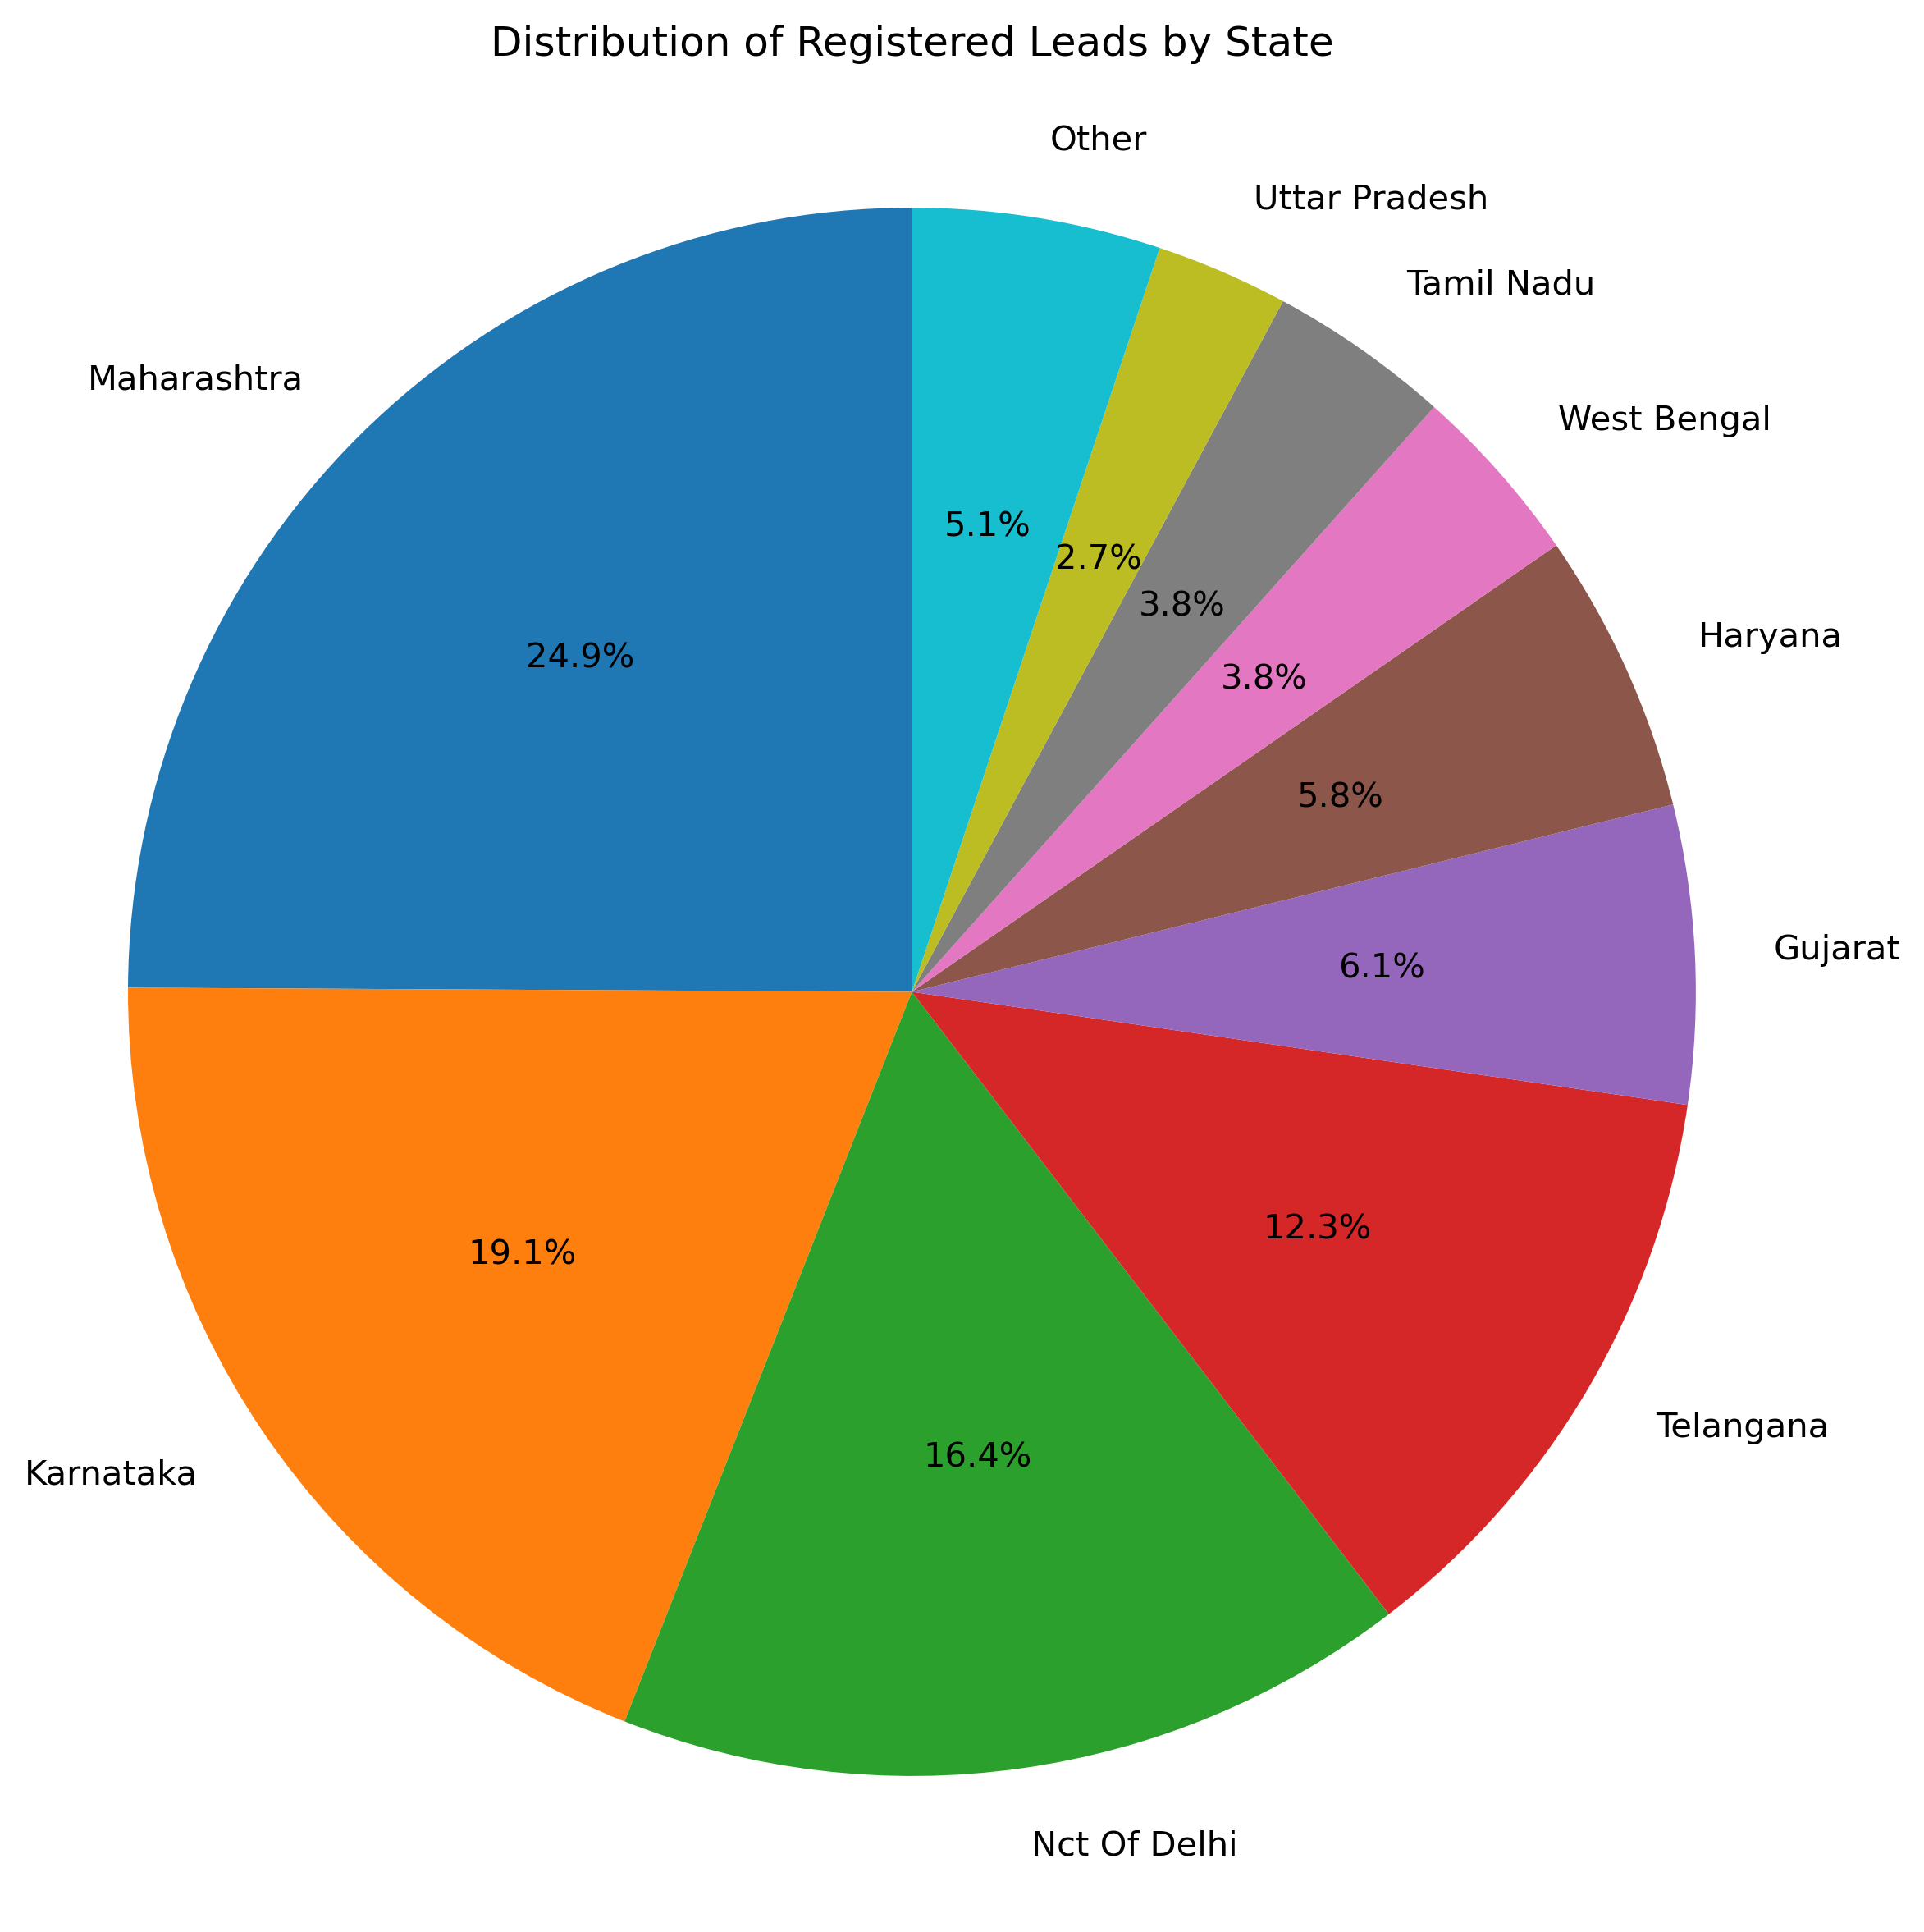
Number Of Entries: 457
Notes:
Distribution of registered leads by state
Maharashtra is the biggest contributor of registered leads followed by Karnataka

Slide 11
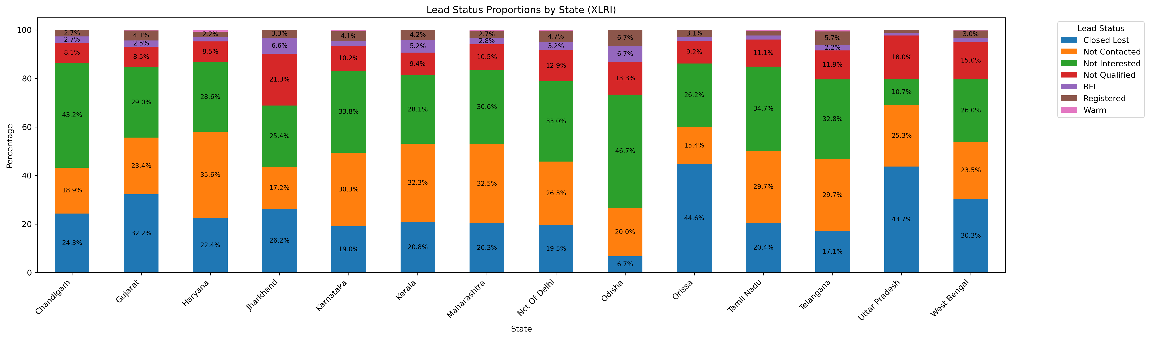
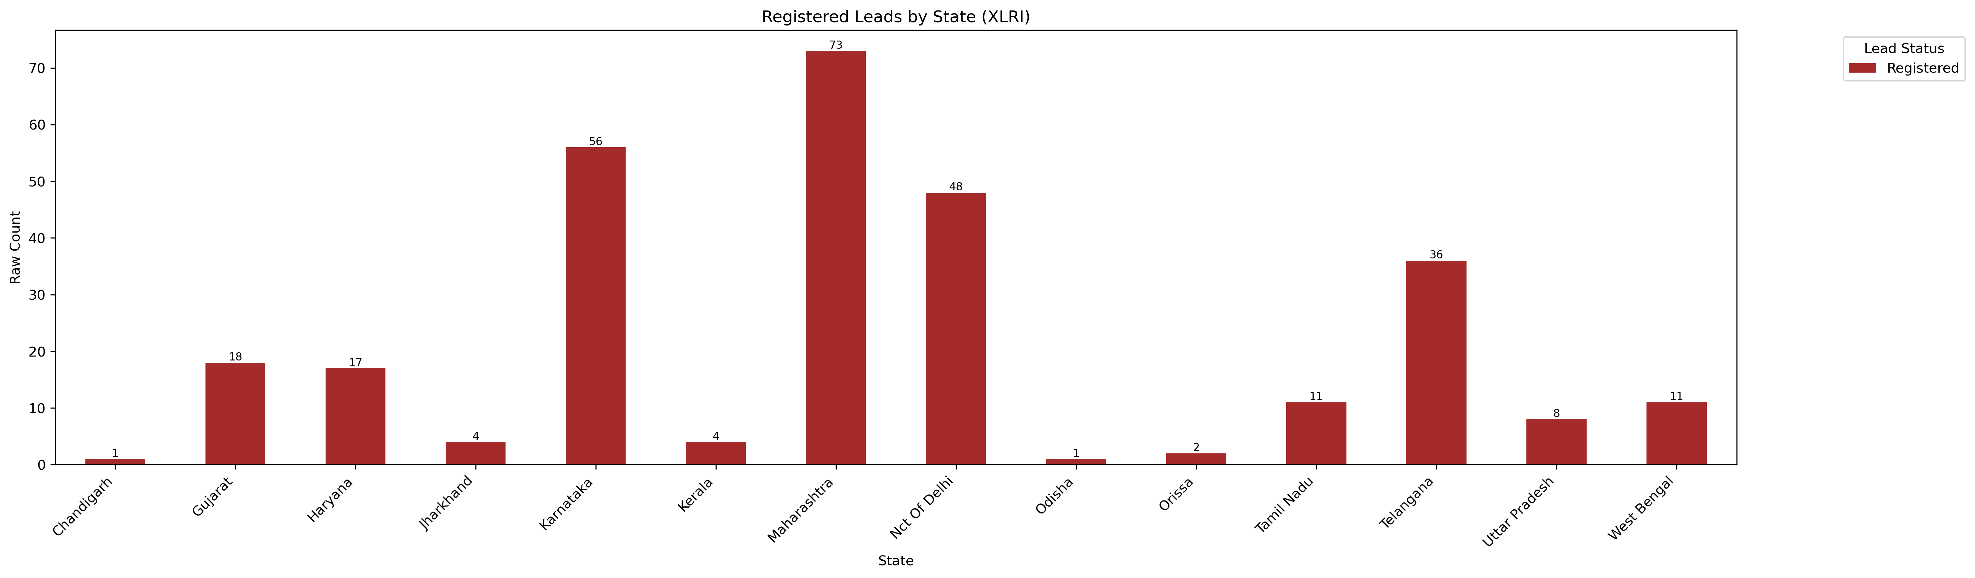
Notes:
Graphs showing states with any successful conversions
Top Graph is taking a closer and clearer look at those states by percentage of lead statuses
Bottom graph is raw counts of registered leads by state
Using a reference of having 10 registered leads as a “successful” state, the 8 best states are Gujarat, Haryana, Karnataka, Maharashtra, Nct Of Delhi, Tamil Nadu, Telangana, and West Bengal

Slide 12
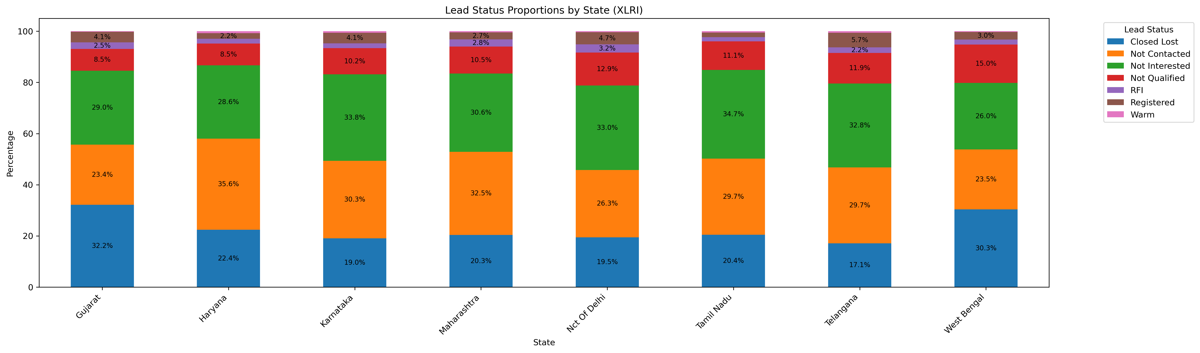
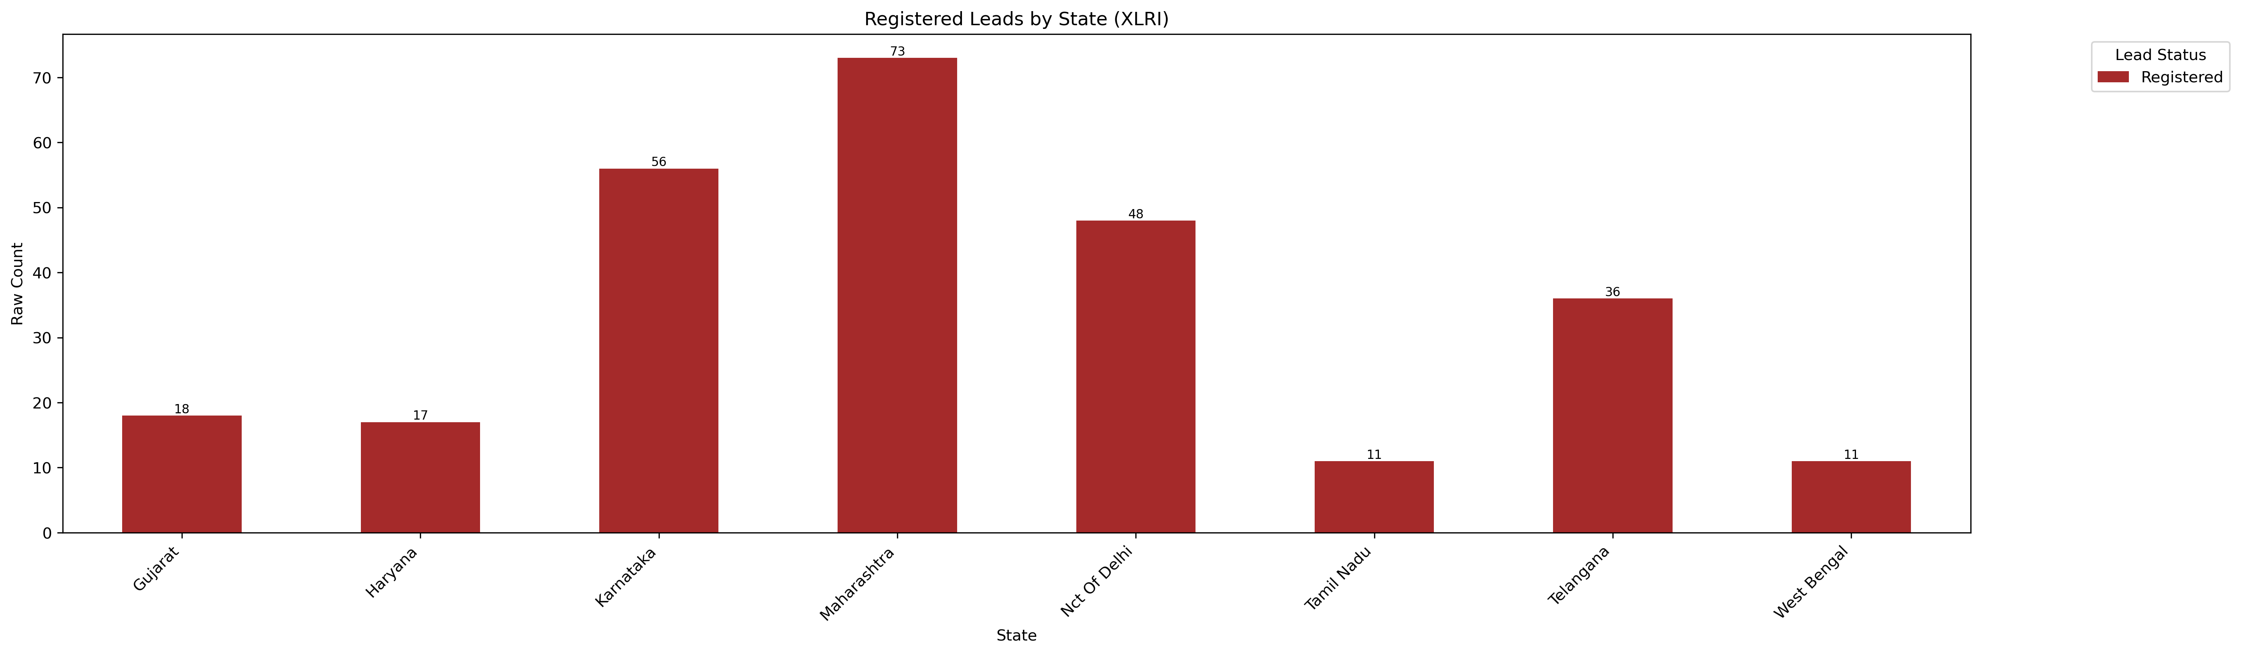
Notes:
- Graphs focusing further on the 8 states with more than 10 converted leads

Slide 13
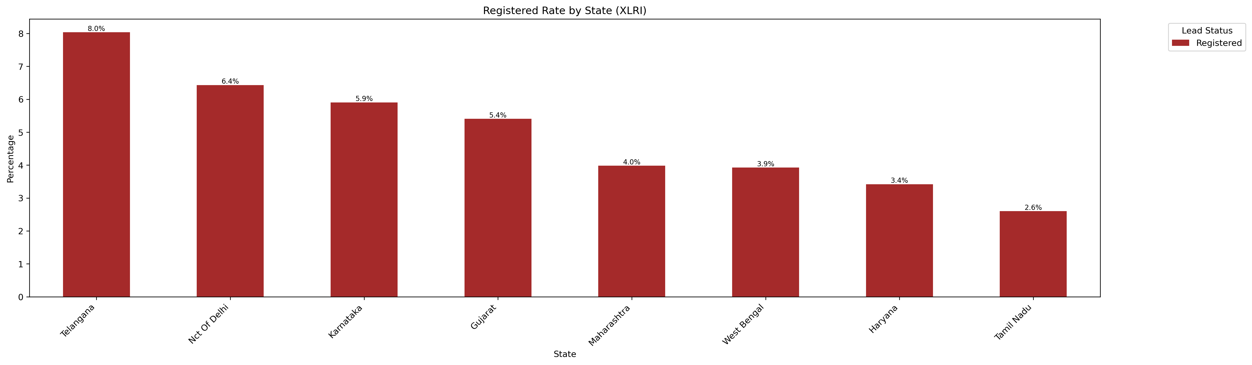
Notes:
Graph showing lead conversion rates by state
Telangana the largest with a 5.7% conversion rate
Top 4 states all with conversion rates above 4% are Telangana, Nct of Delhi, Gujarat, and Karnataka
Bottom 3 States with conversion rates below 3% are Maharashtra, Haryana, and Tamil Nadu

Slide 14
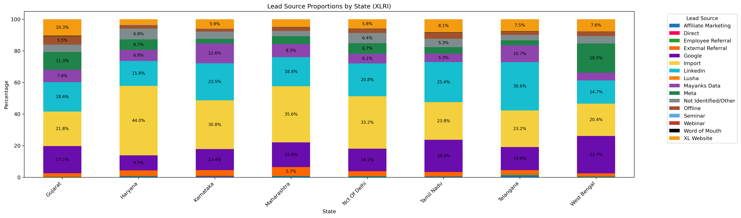
Number Of Entries: 17272
Notes:
Lead source proportions by state, only inclusive of the 8 states that will be focused on
Majority of states have Linkedin as the biggest contributor of leads

Slide 15
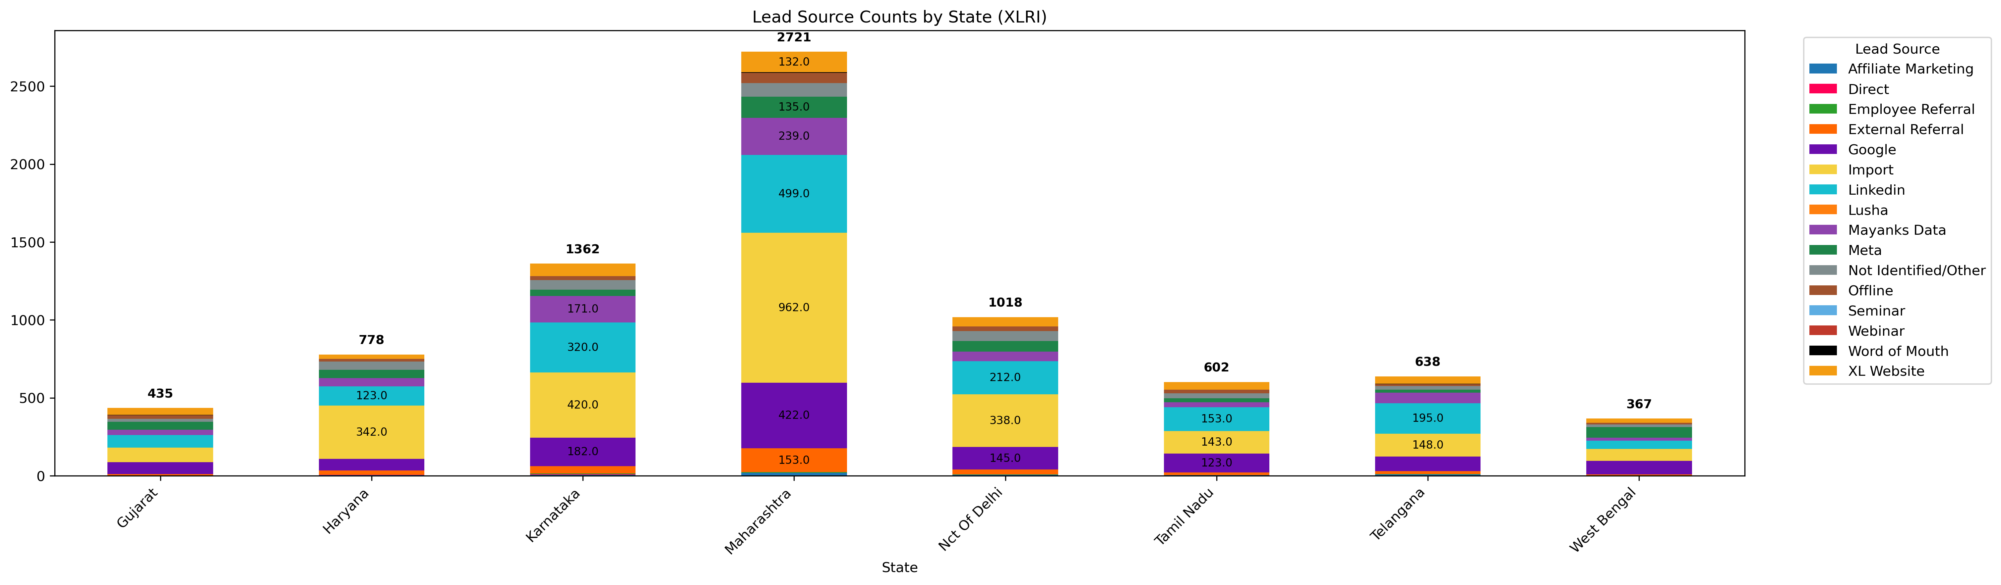

Slide 16
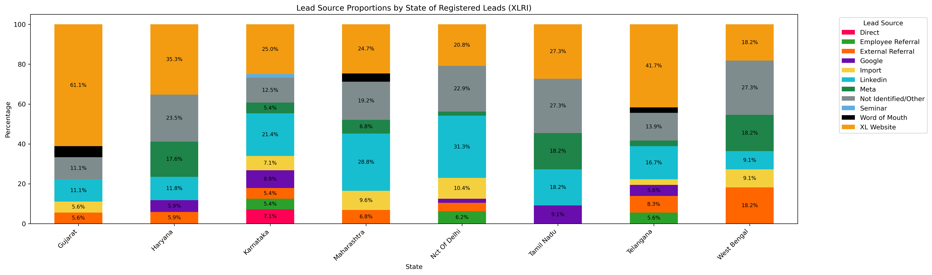
Notes:
- Graphs focusing further on the 8 states with more than 10 converted leads

Slide 17
City Data and Demographics
Notes:
- Nct of Delhi and Telangana cities will not be highlighted since both of these states had most of their data come from a singular city with Nct of Delhi having Delhi and Telangana having Hyderabad

Slide 18
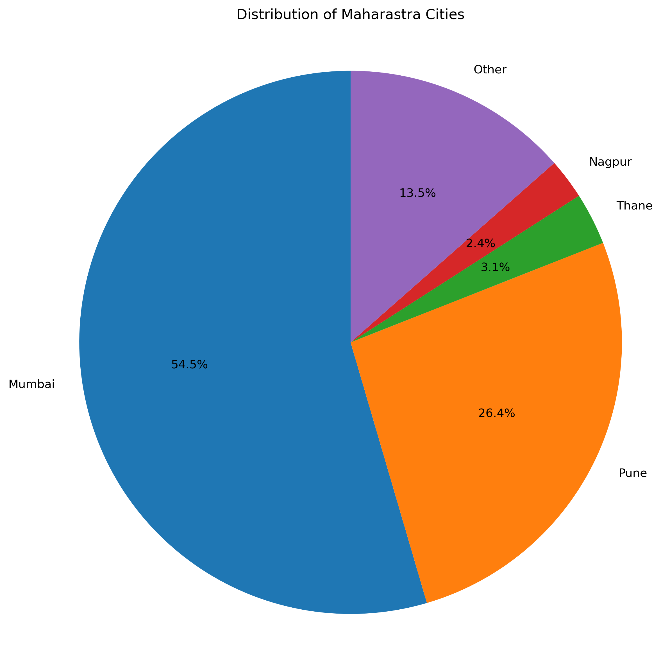
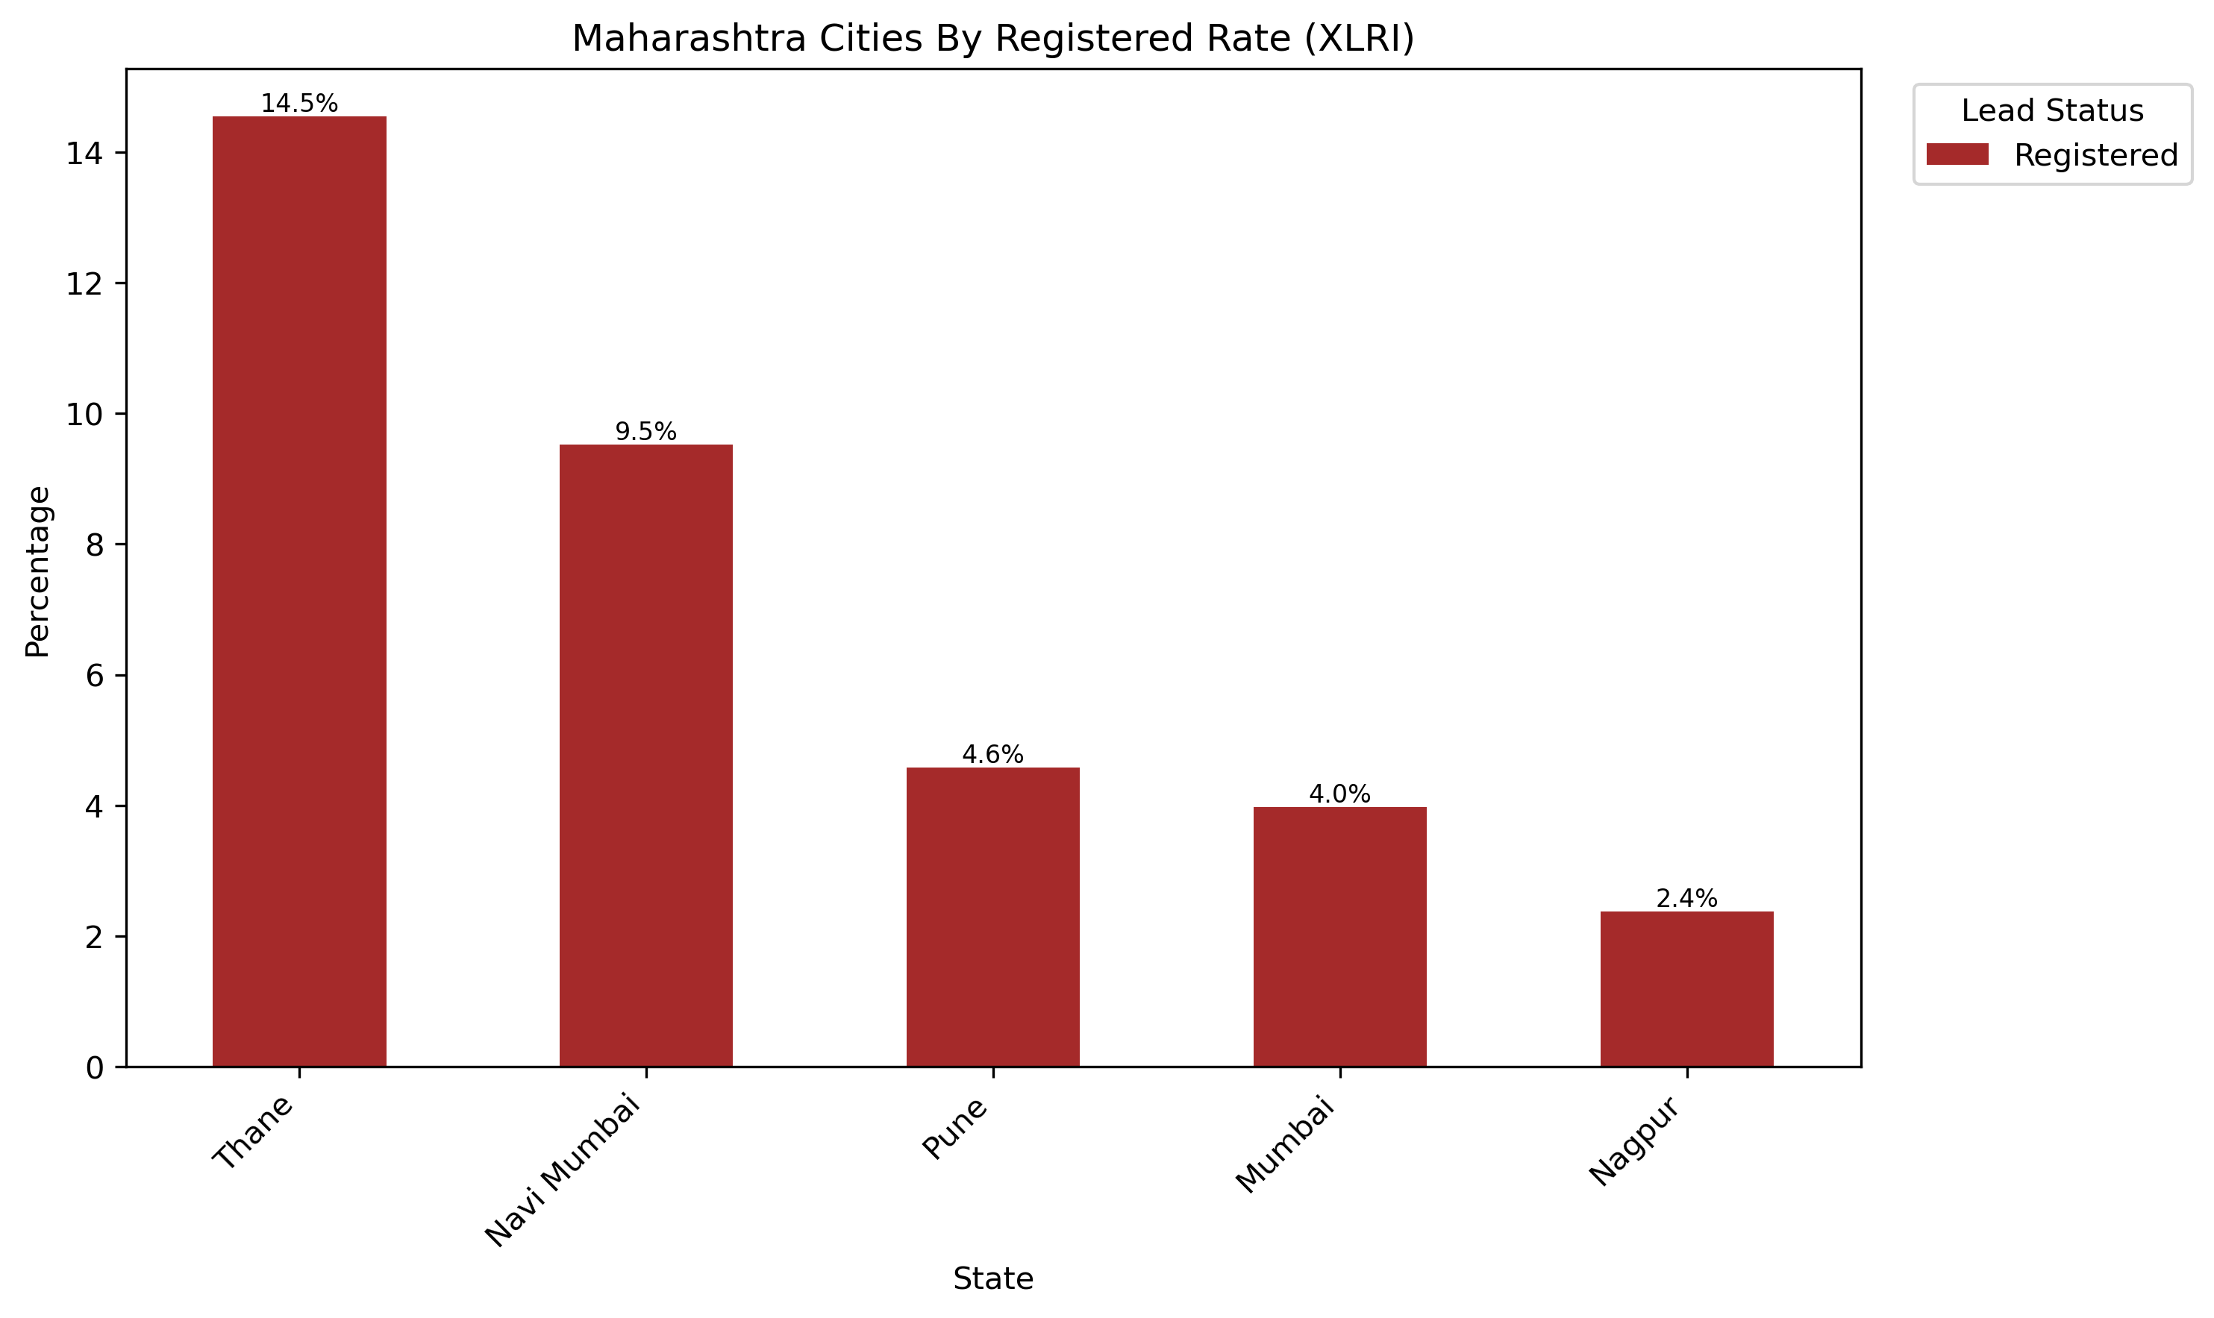
Number Of Entries: 2721
Key Markets:
Mumbai
Pune
Thane
Navi Mumbai
Notes:
- Majority of leads from Maharashtra come from Mumbai and Pune
Graph on right only include cities with 10 or more entries, will stay same for following city analysis
Cities with any conversion are Mumbai, Nagpur, Navi Mumbai, Pune, and Thane
Cities that should be focused on are Mumbai, Pune, Thane, and Navi Mumbai

Slide 19
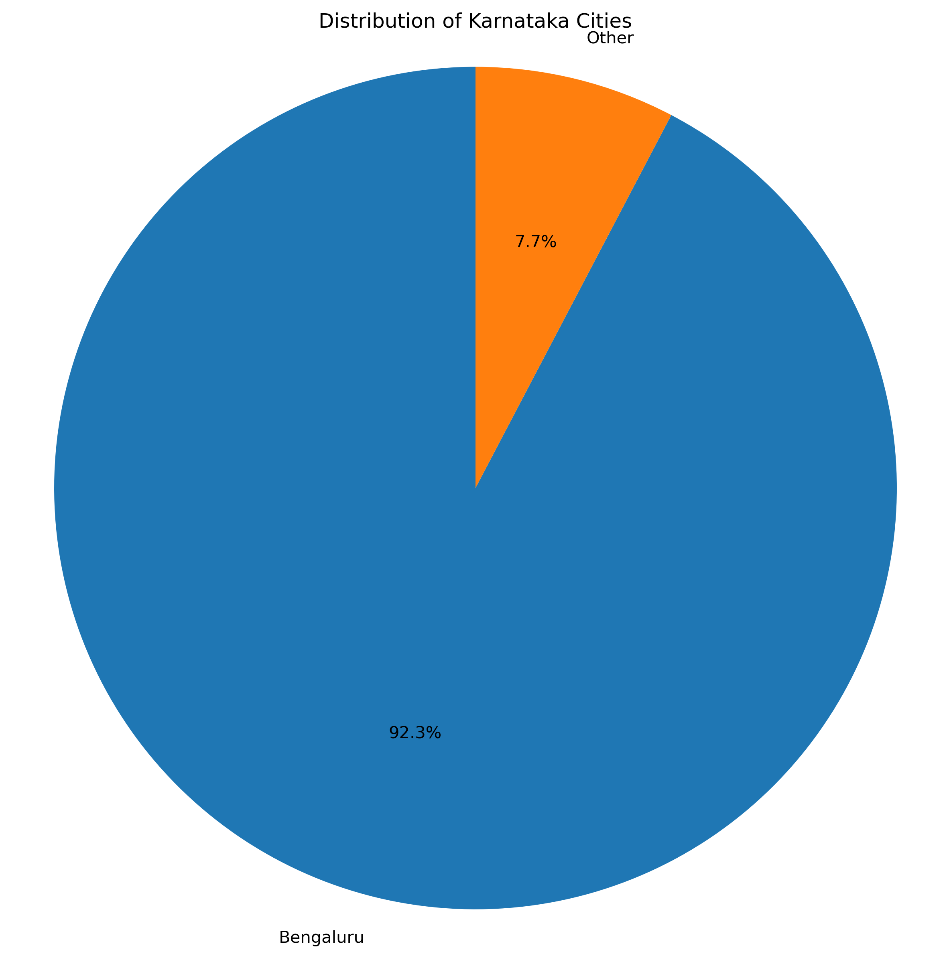
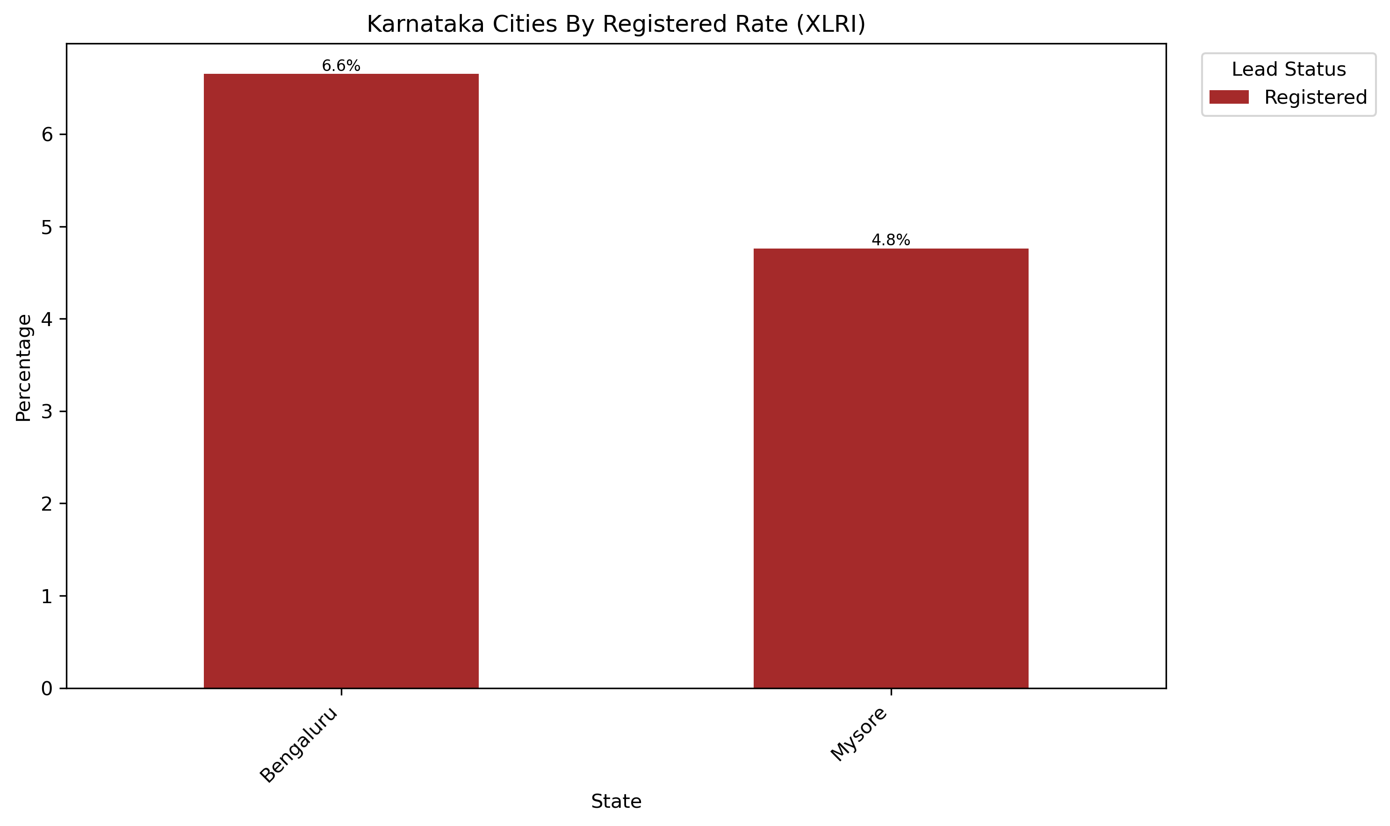
Number Of Entries: 1362
Key Markets:
Bengaluru
Mysore
Notes:
Majority of leads from Karnataka are from Bengaluru
Cities with any conversion are Bengaluru and Mysore
Karnataka cities to be focused on are Bengaluru and Mysore

Slide 20
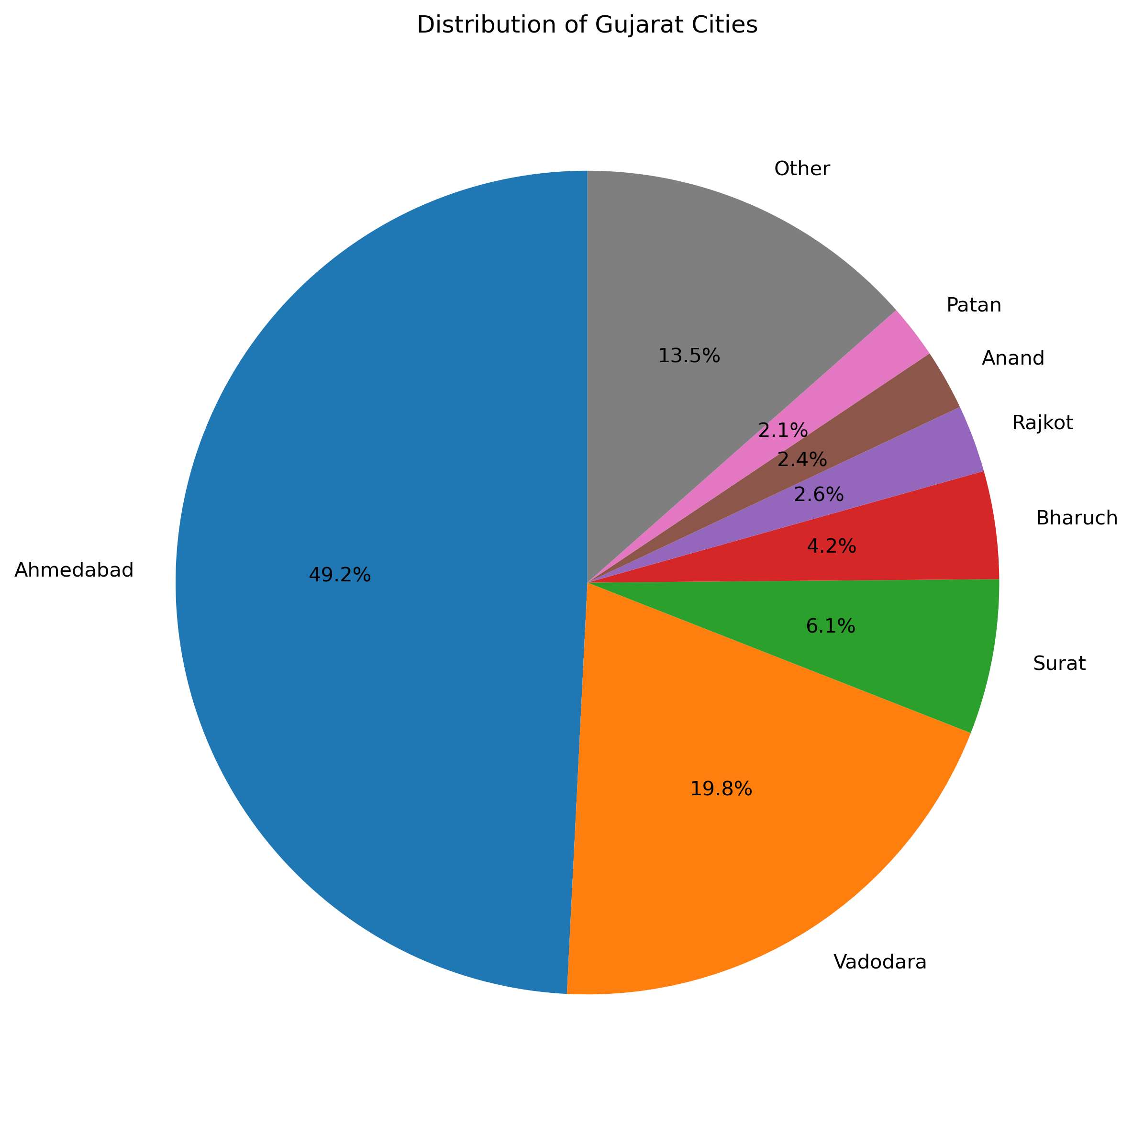
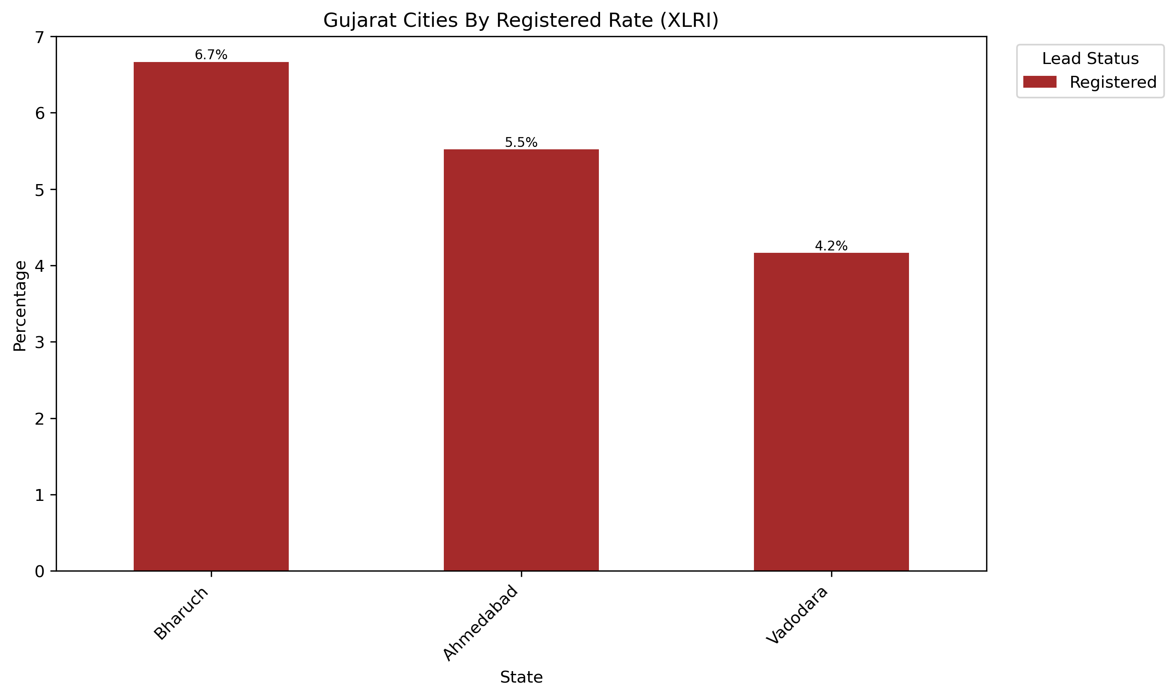
Number Of Entries: 435
Key Markets:
Ahmedabad
Vadodara
Bharuch
Notes:
Majority of leads from Gujarat are from Ahmedabad, Vadodara, Surat, and Bharuch
Cities with any conversion are Ahmedabad, Bharuch, Vadodara
Cities that should be targeted are Ahmedabad, Bharuch, and possibly Vadodara

Slide 21
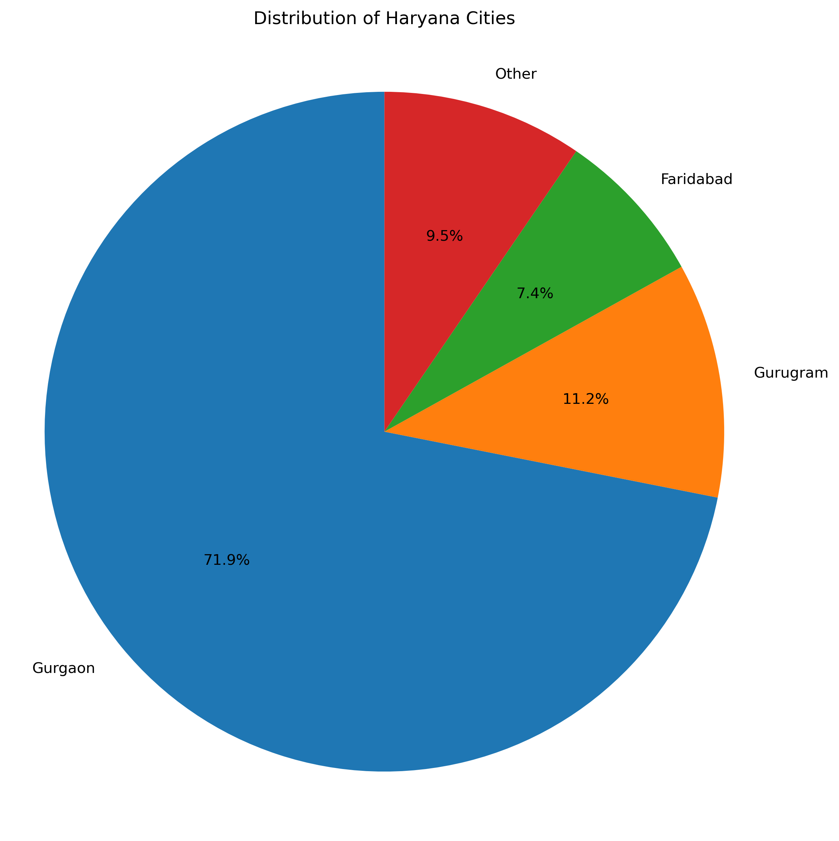
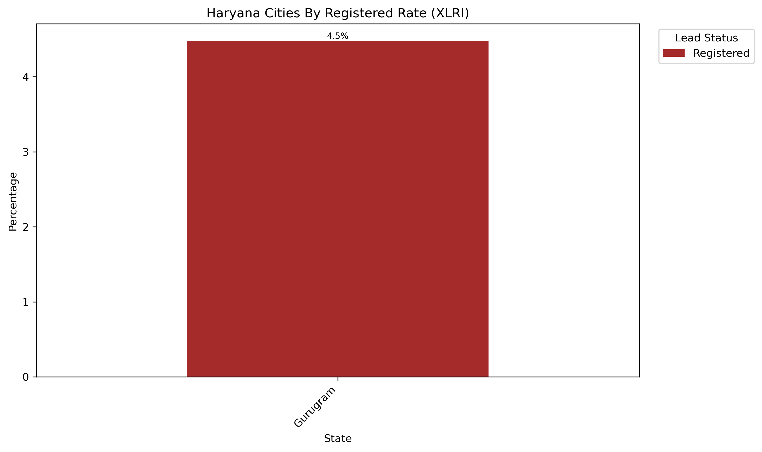
Number Of Entries: 778
Key Markets:
Gurugram
Notes:
Majority of leads from Haryana are from Gurgaon, Gurugram, and Faridabad
Cities with any conversion are Gurgaon and Gurugram
Cities that should be targeted are Gurgaon and Gurugram

Slide 22
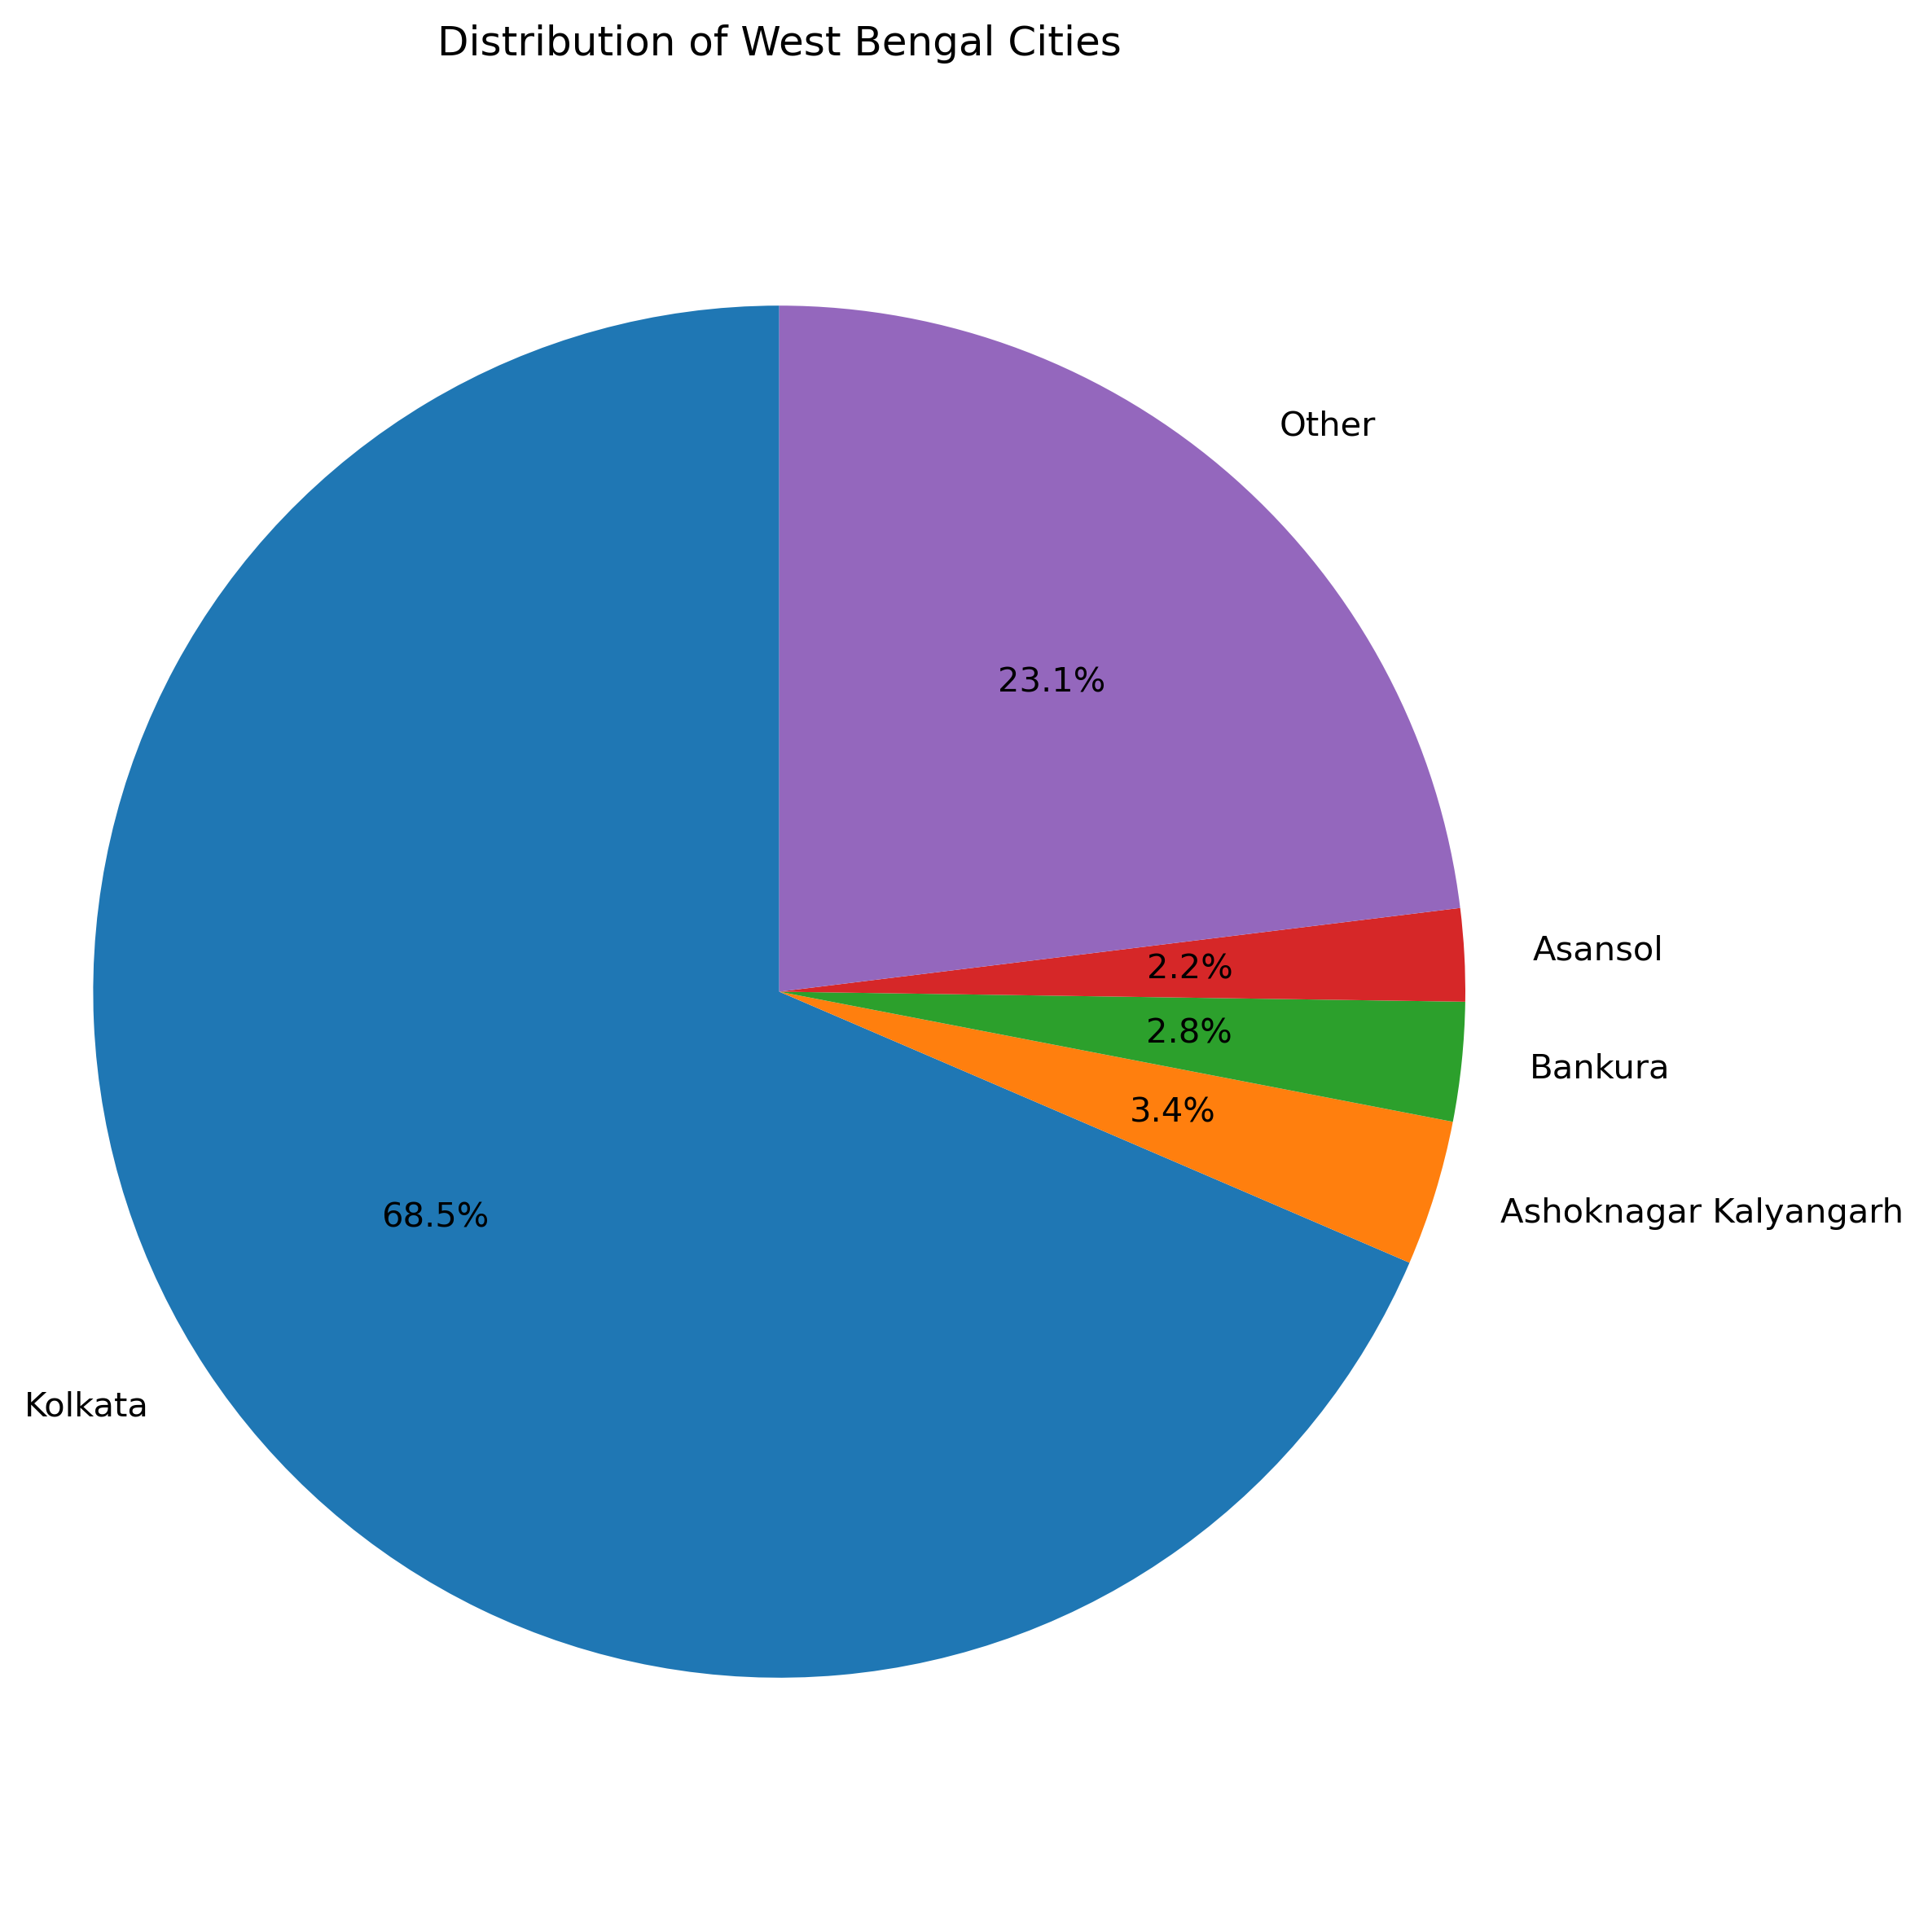
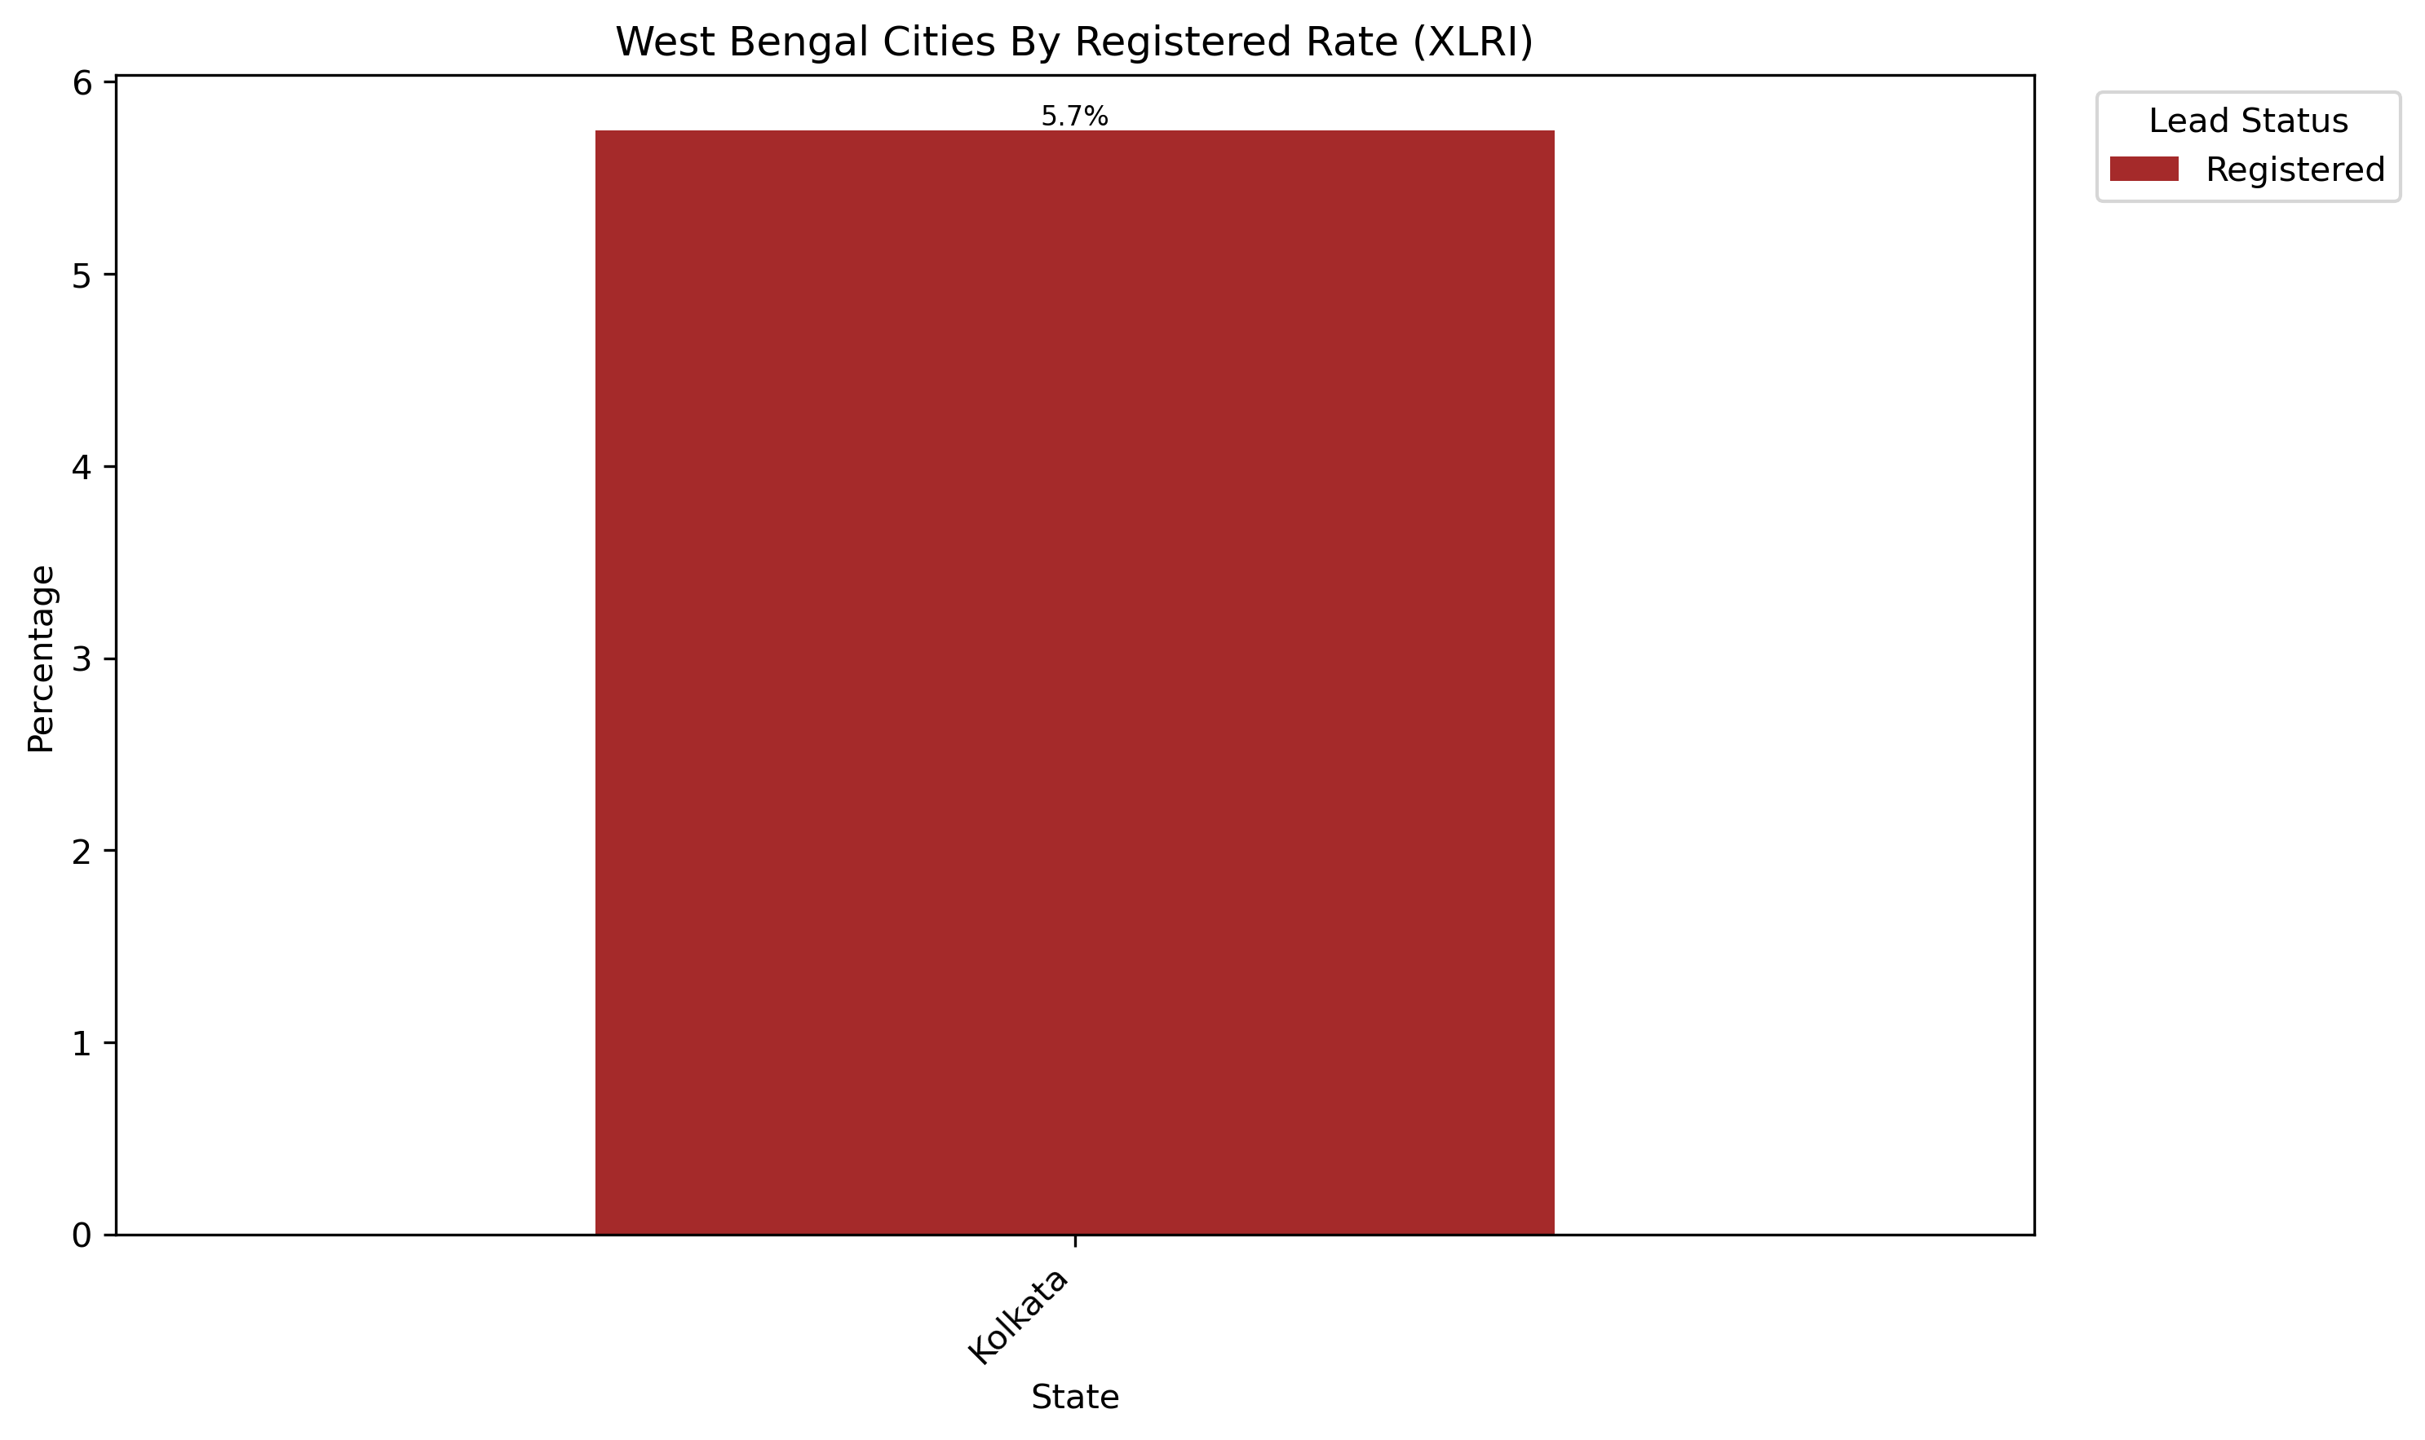
Number Of Entries: 367
Key Markets:
Kolkata
Notes:
Majority of leads from West Bengal are from Kolkata and Ashoknagar Kalyangarh
Kolkata is the only city with any conversions
Kolkata is the only West Bengal city that should be targeted

Slide 23
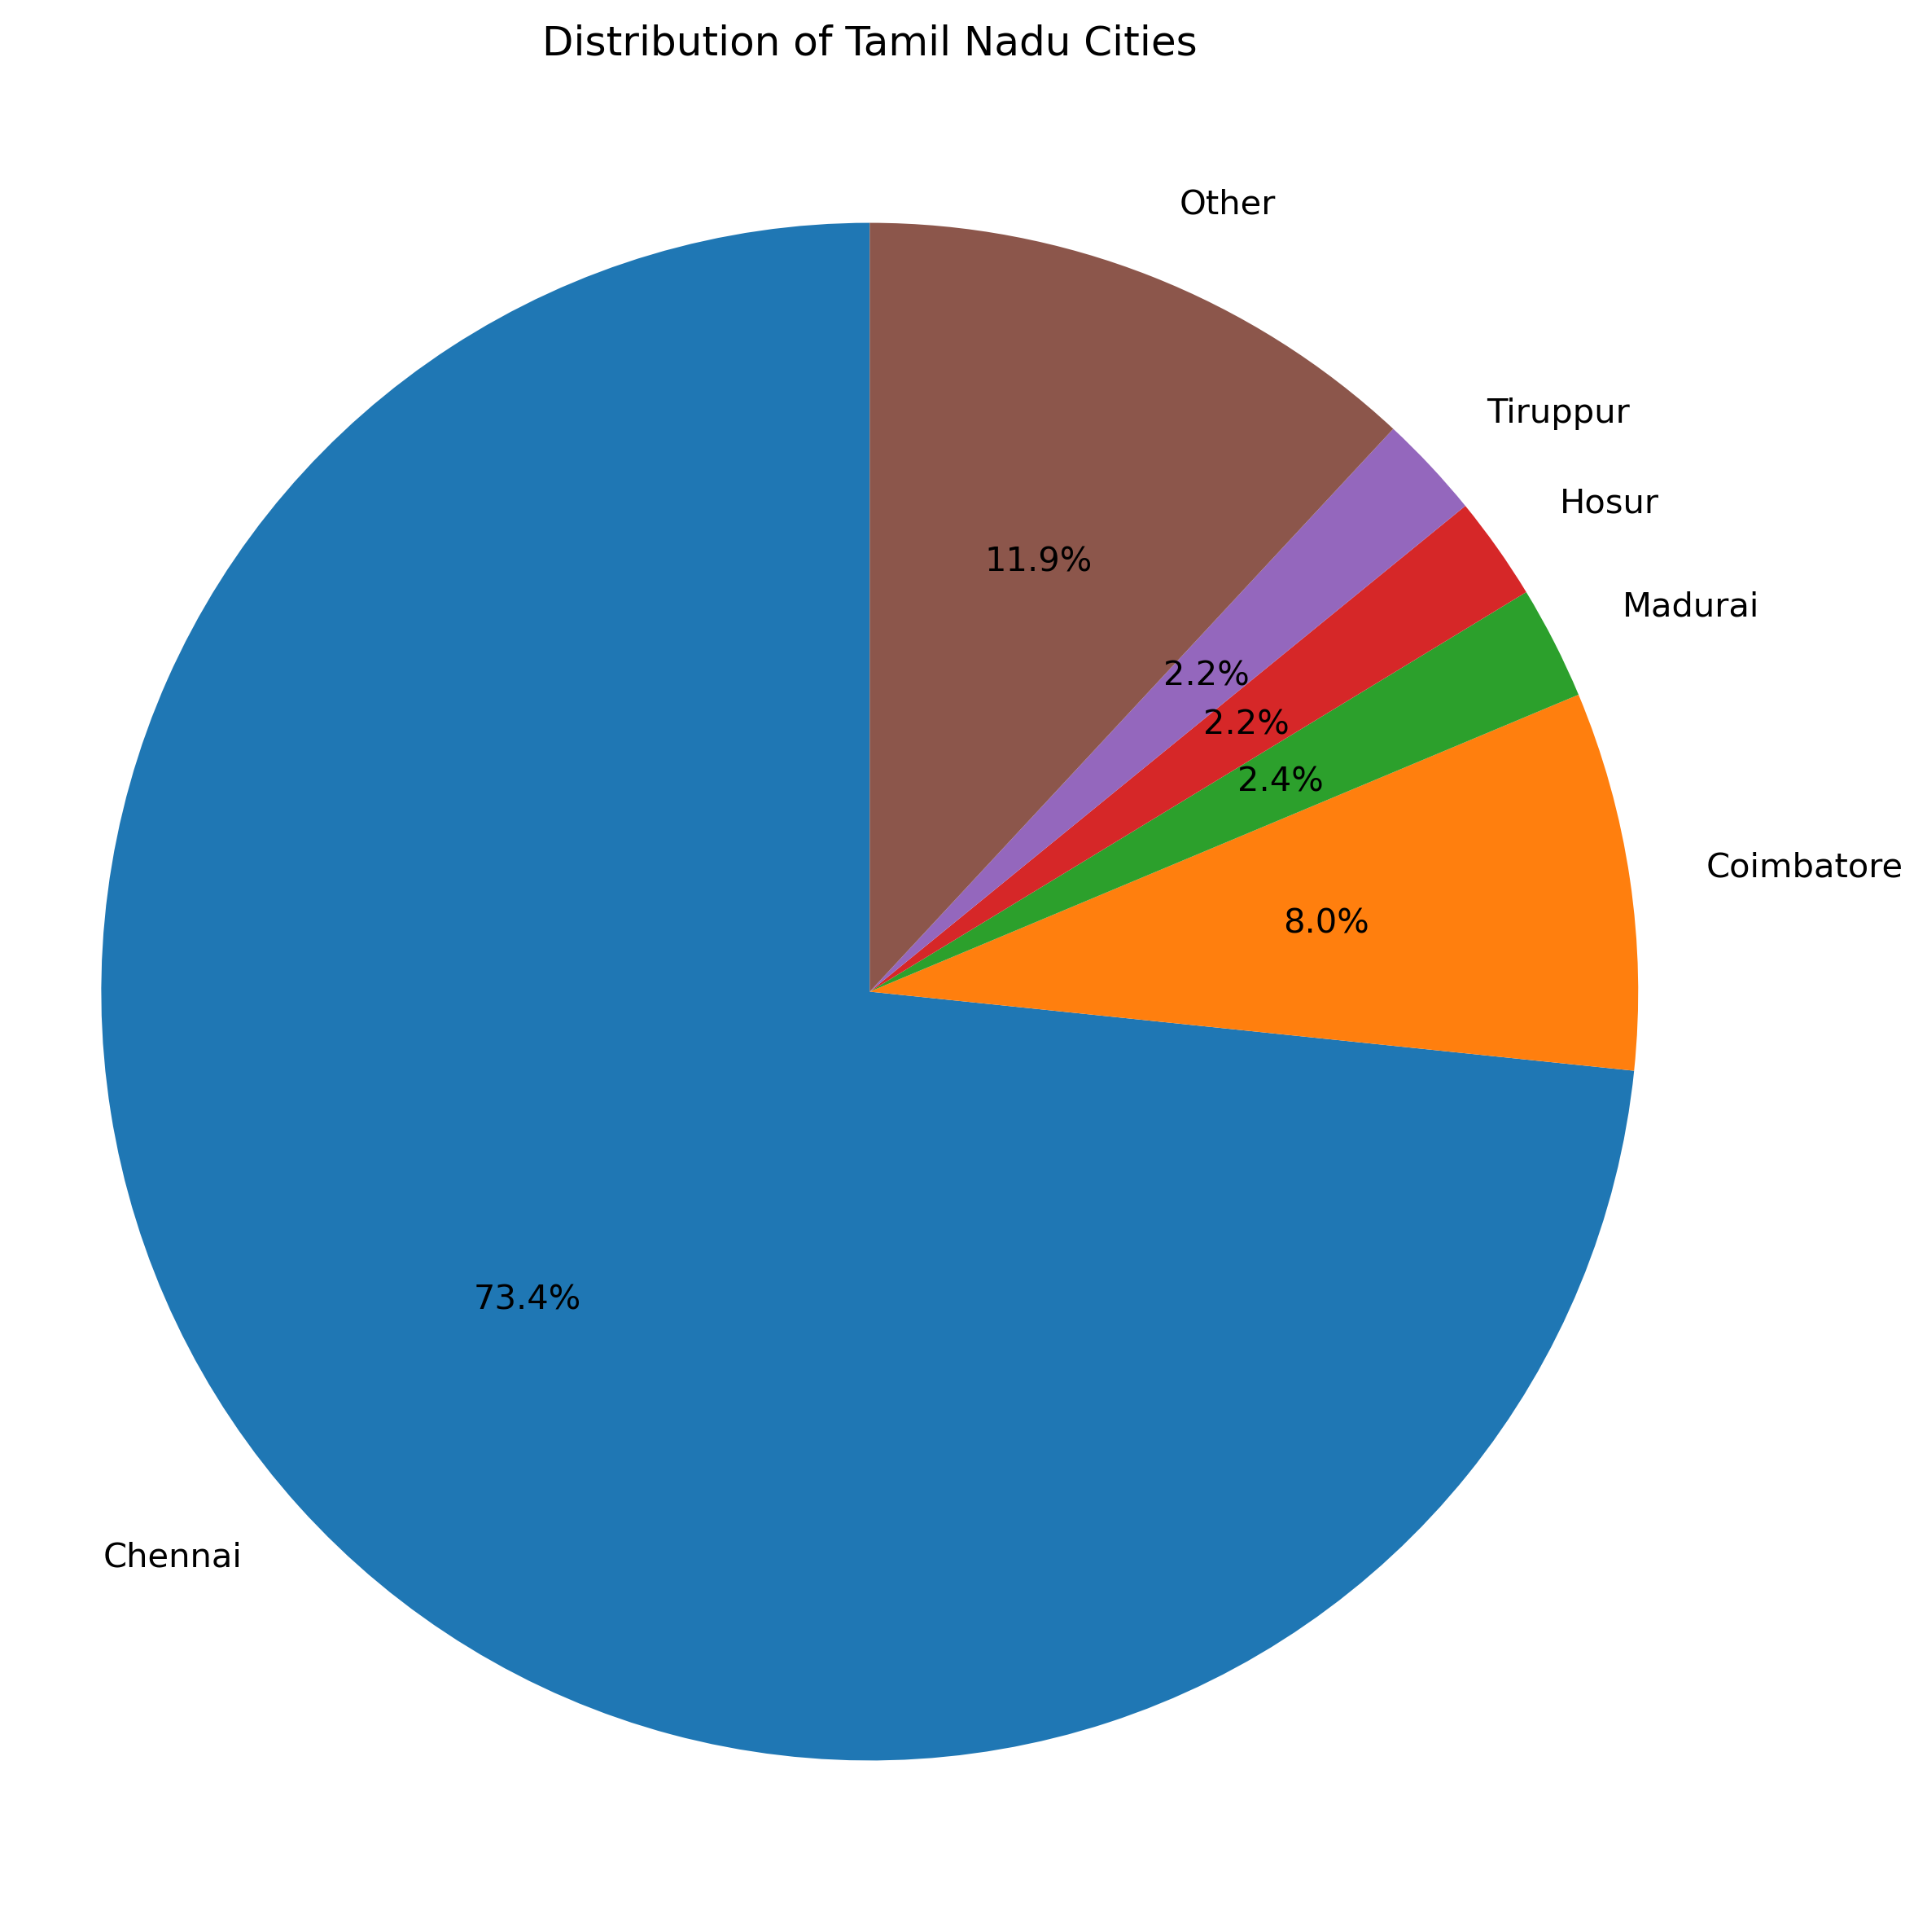
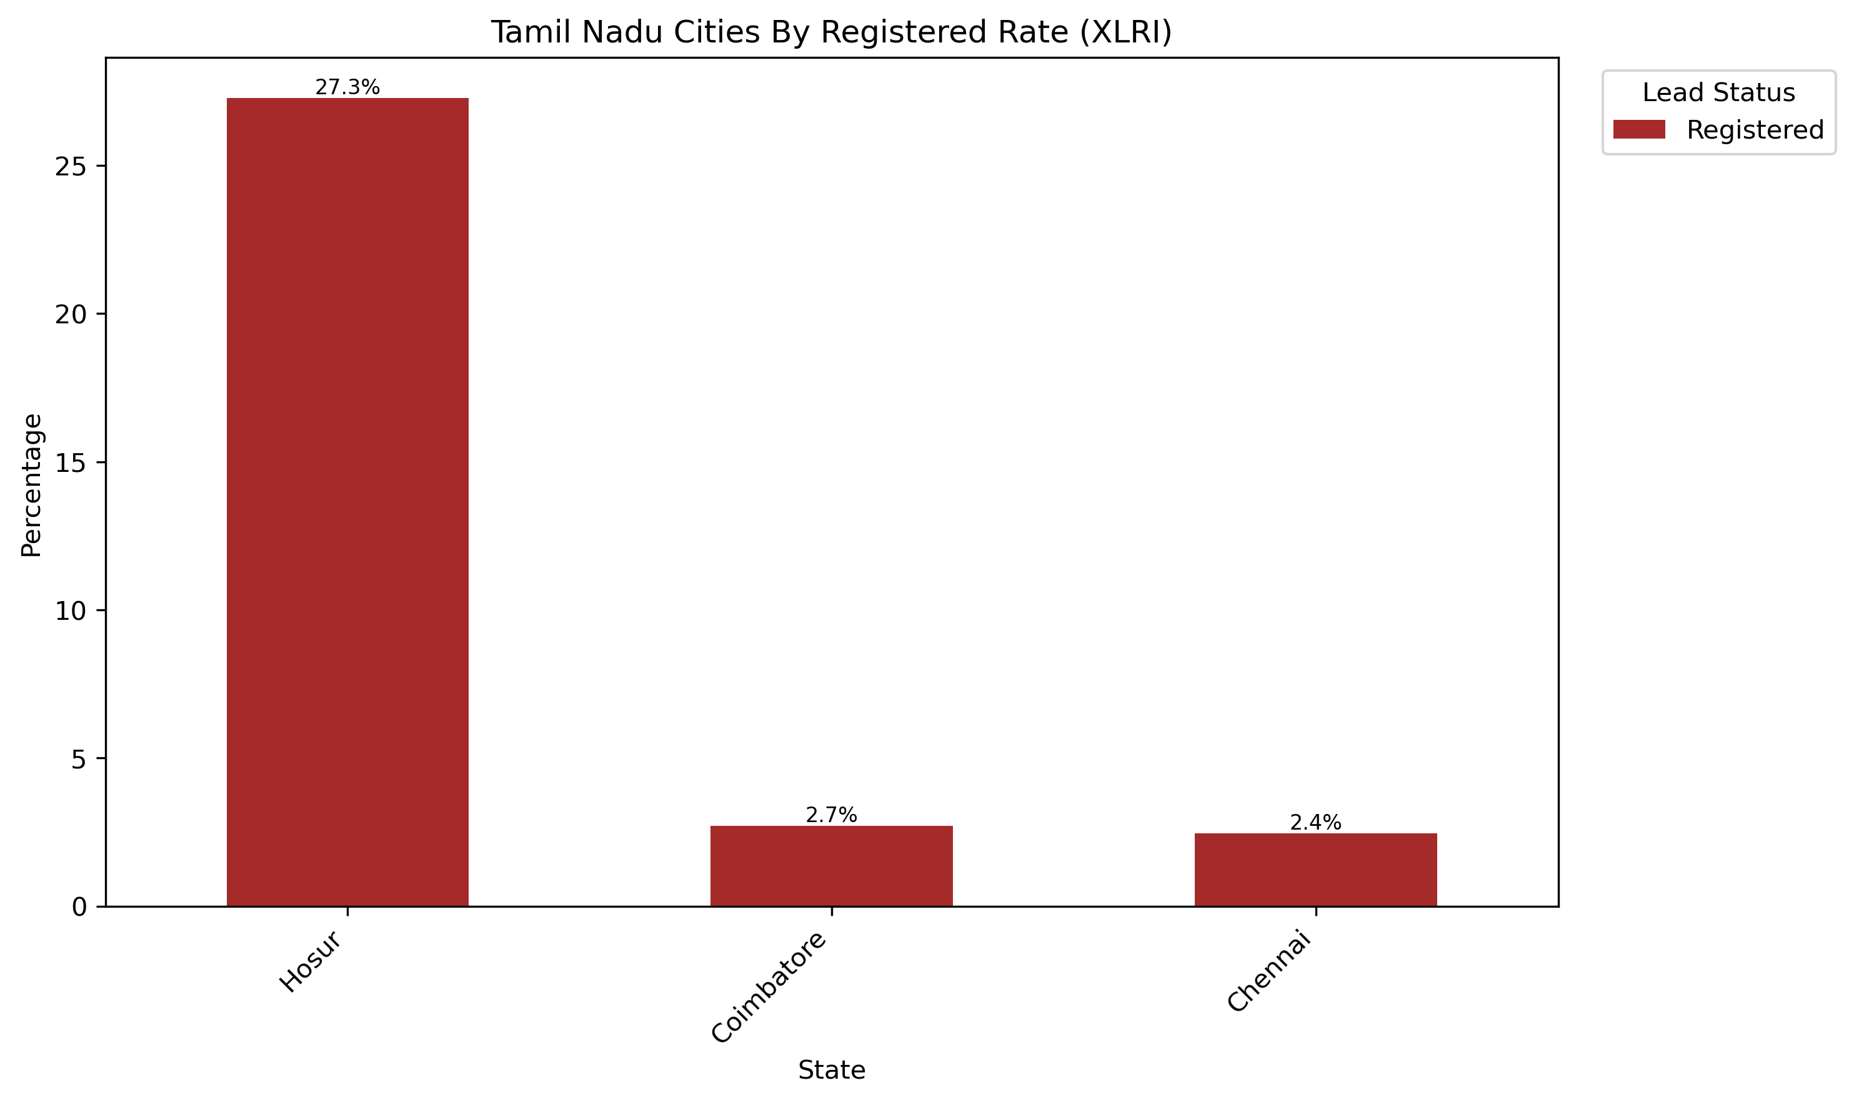
Number Of Entries: 602
Key Markets:
Chennai
Coimbatore
Hosur
Notes:
Majority of leads from Tamil Nadu are from Chennai and Coimbatore
Cities with any conversion are Chennai, Coimbatore, and Hosur
Cities that should be targeted are Chennai, Coimbatore, and Hosur

Slide 24
Work Experience Data and Demographics
Notes:
- Work experience Data and Demographics

Slide 25
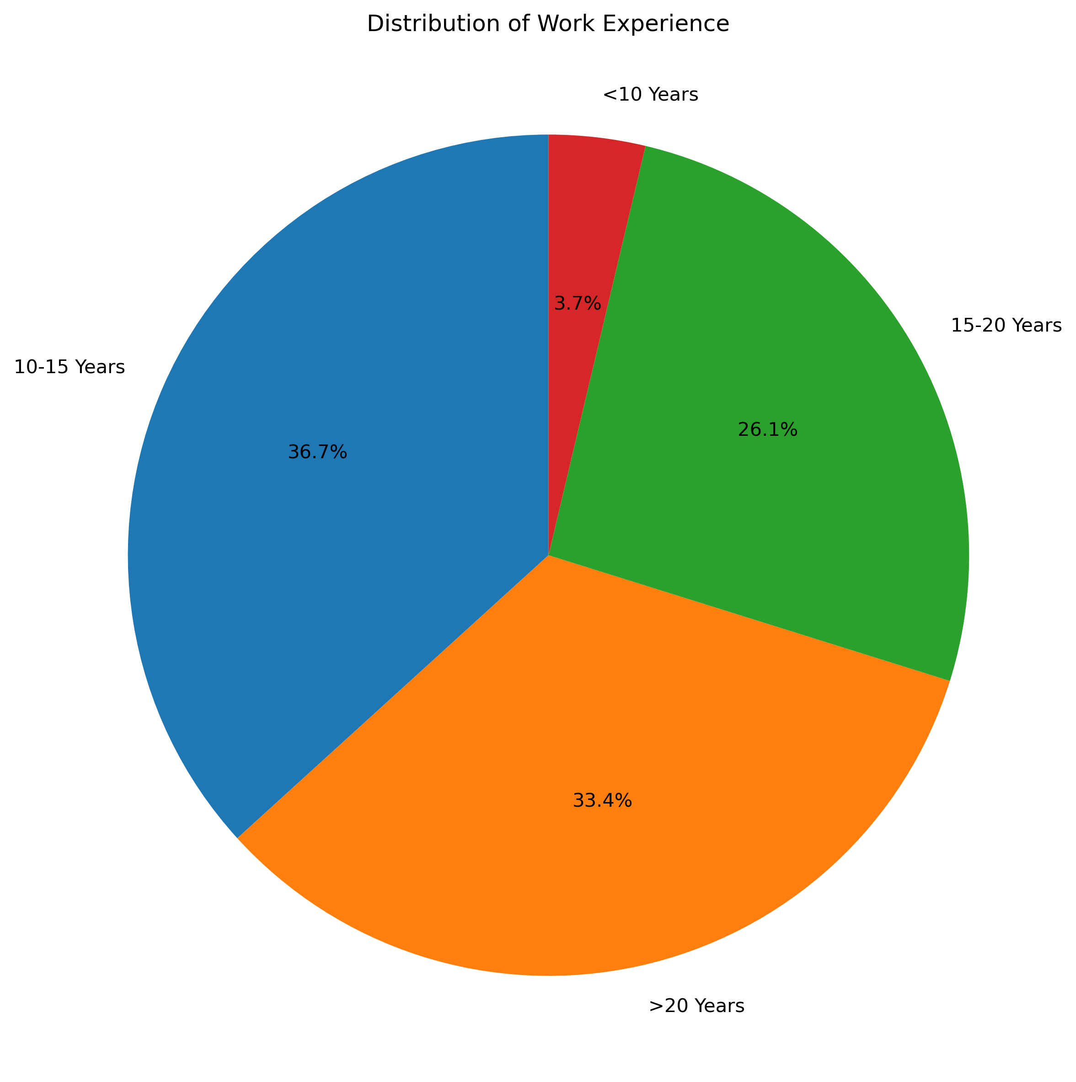
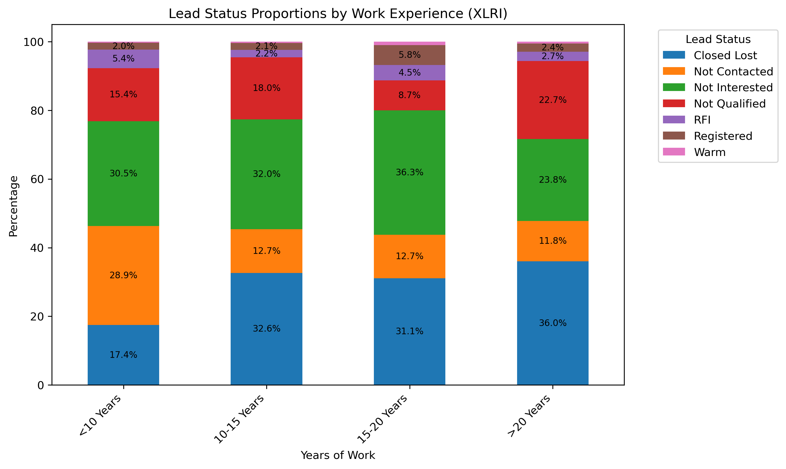
Number Of Entries: 8042
Notes:
- Leads generally come from the 10-15 years of work experience bucket and the >20 years of work experience bucket
- 15-20 years is also a large bucket, but not as large
15-20 years though has the largest conversion rate at 5.8%

Slide 26
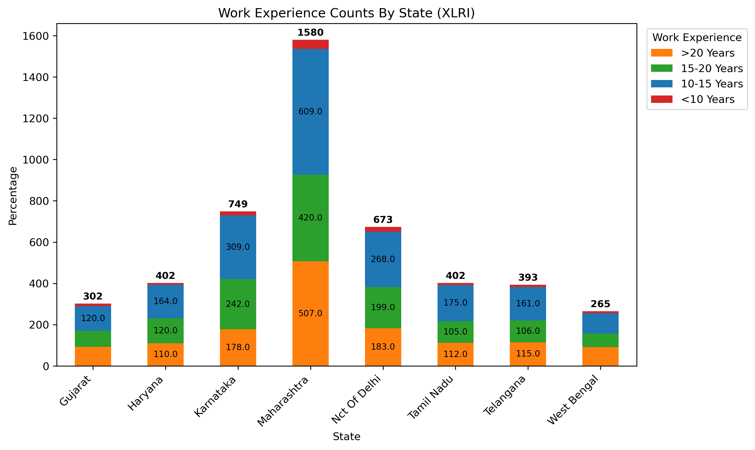

Slide 27
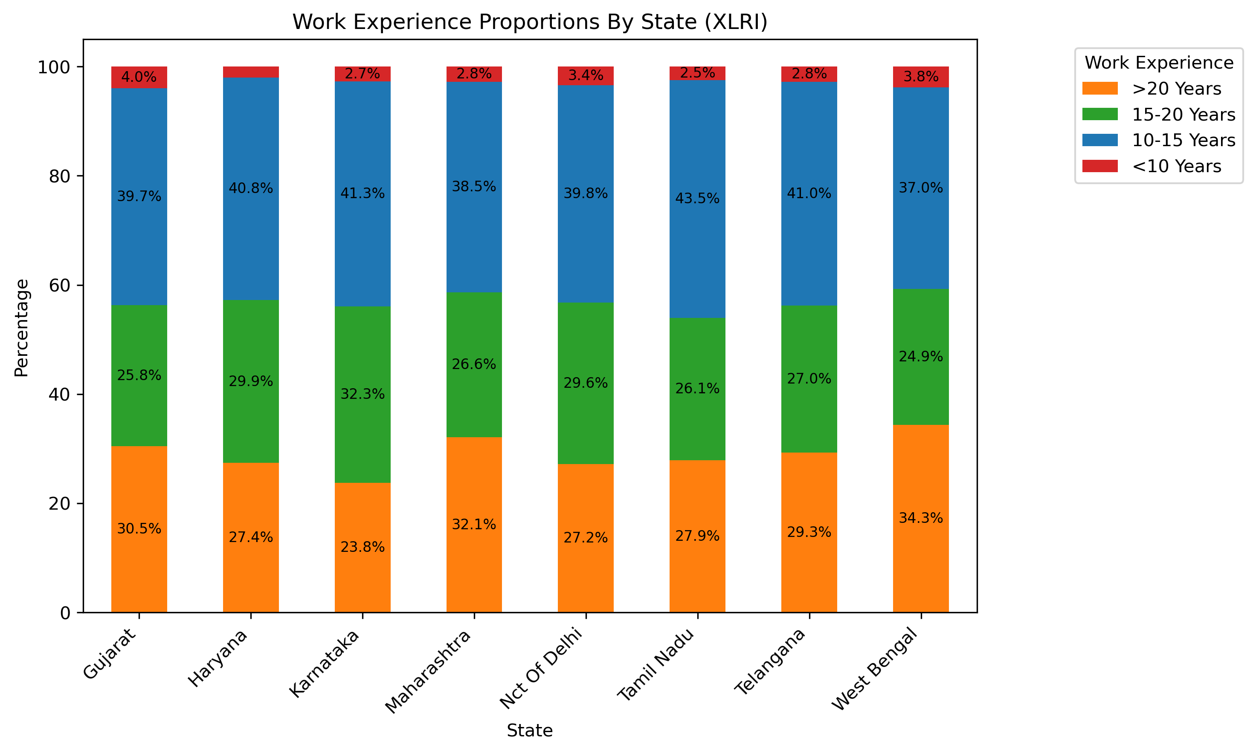
Notes:
All states have the 10-15 year work experience bucket as the largest
States such as Gujarat, Maharashtra, Tamil Nadu, Telangana, and West Bengal have the >20 years as the second largest bucket
States such as Haryana, Karnataka, and Nct of Delhi have the 15-20 year bucket as the second largest

Slide 28
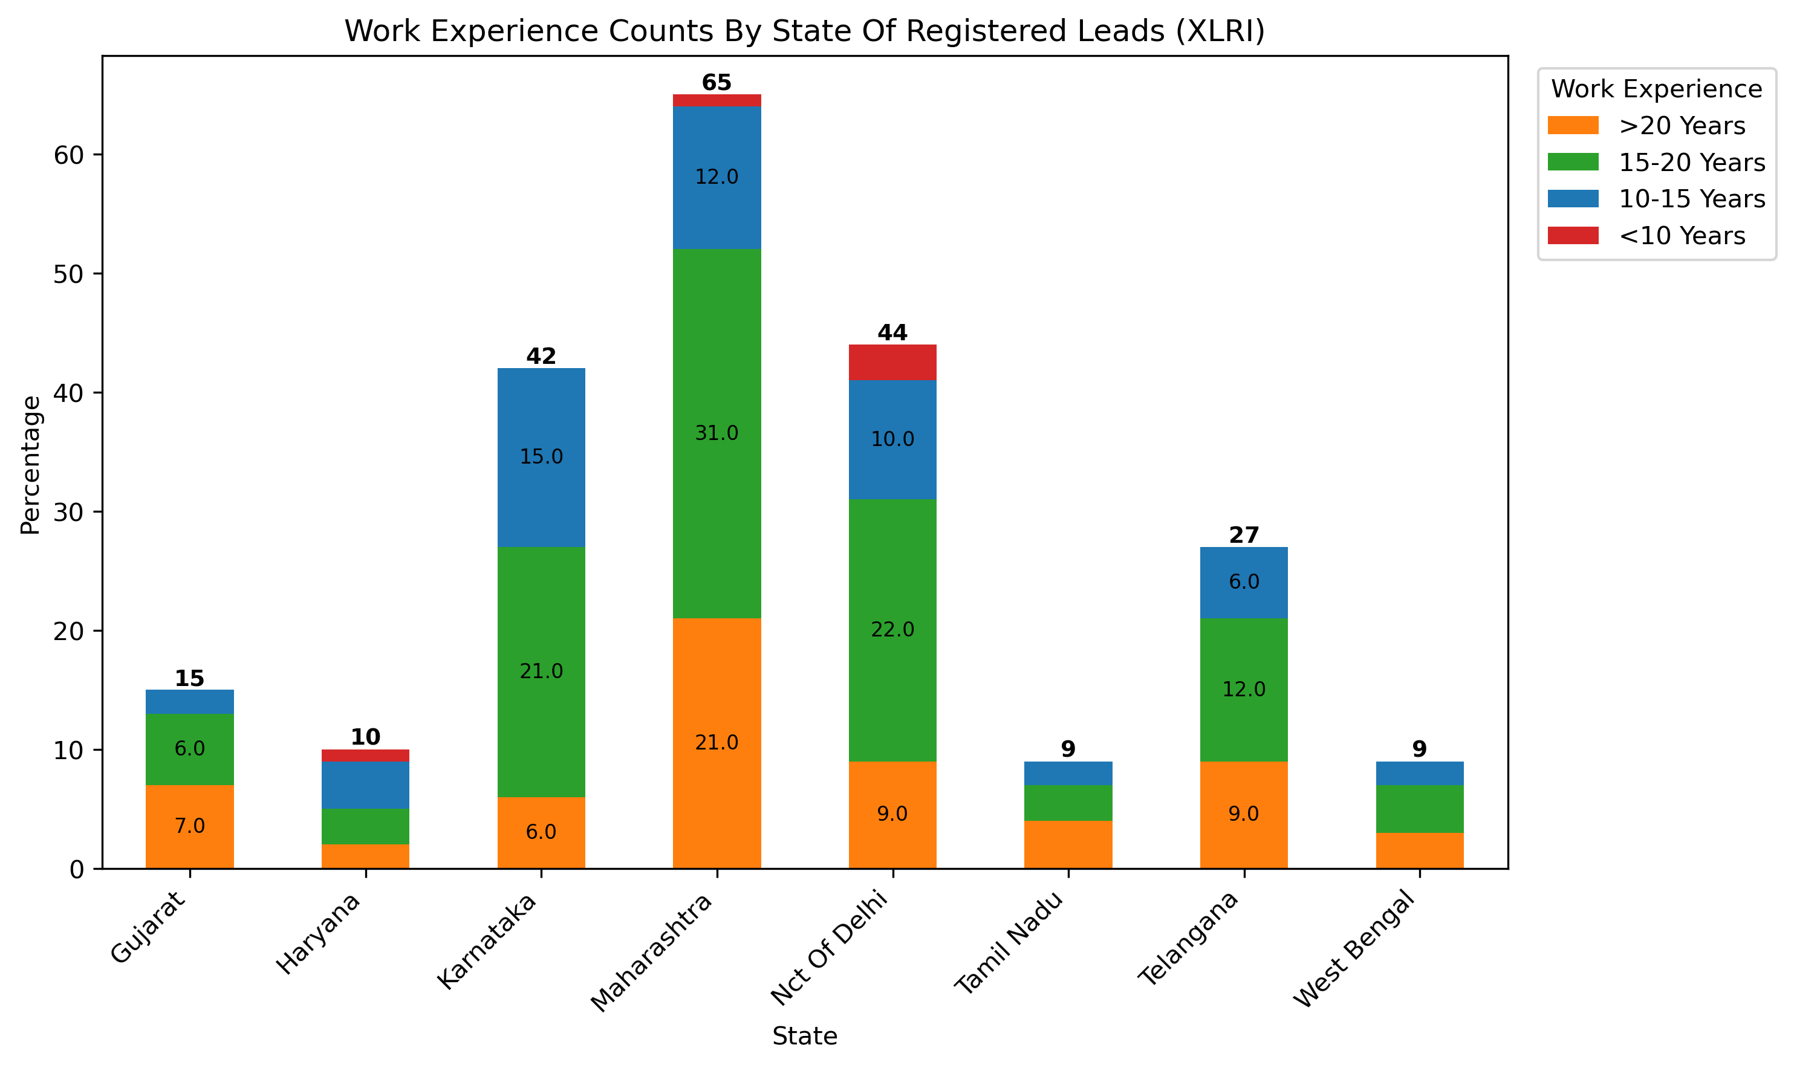

Slide 29
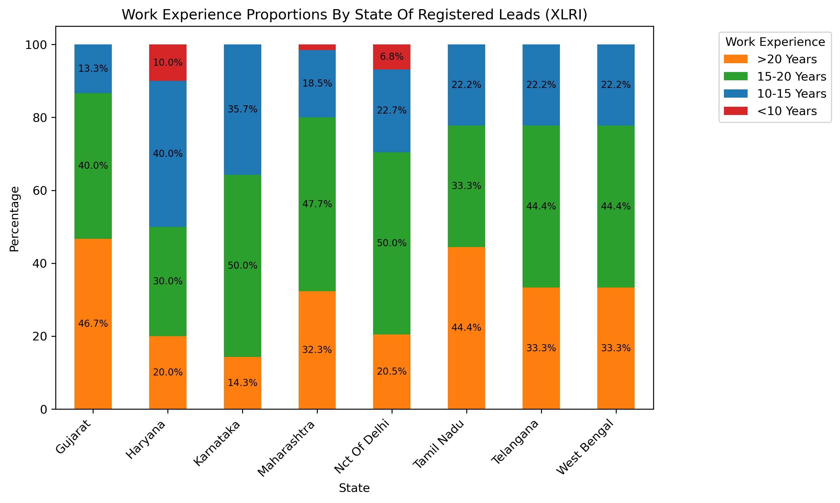
Notes:
Demographics of registered leads are different
Majority of states have 15-20 years are their largest bucket including Karnataka, Maharashtra, Nct Of Delhi, Telangana, and West Bengal
Two states have >20 years as their largest bucket which are Gujarat and Tamil Nadu
Haryana only state with 10-15 years work experience as their largest bucket

Slide 30
Job Position Data and Demographics
Notes:
- Job Position Data and Demographics

Slide 31
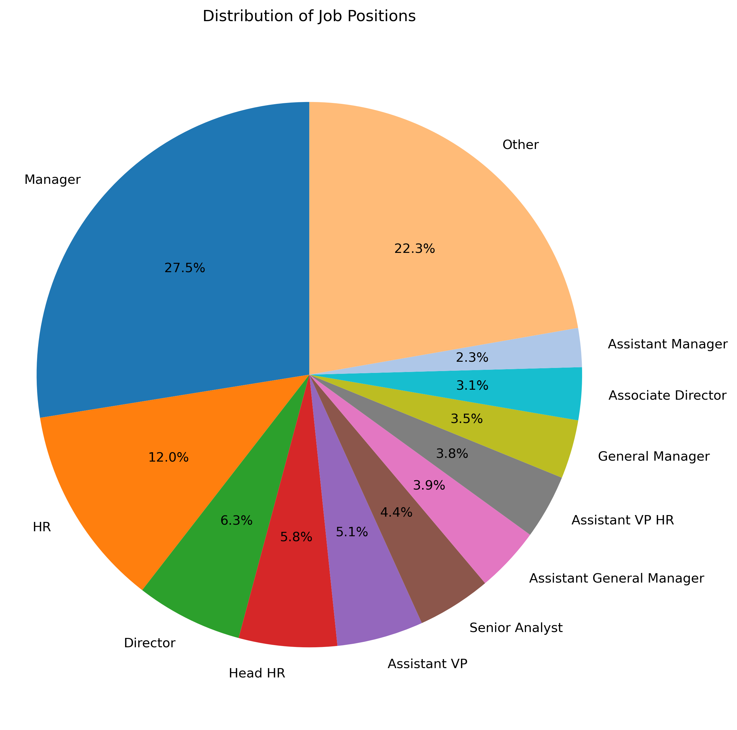
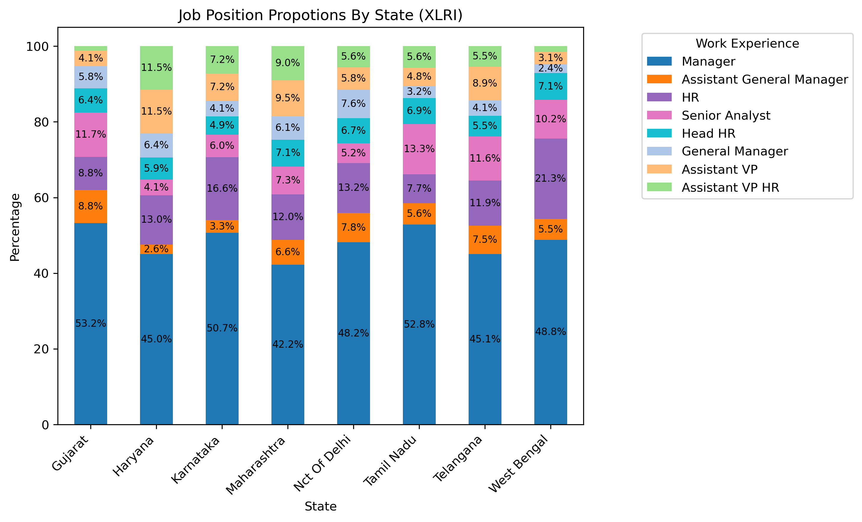
Number Of Entries: 9157
Notes:
Graph on left is a general breakdown of standardized job titles with manager being the largest percentage followed by HR, then director
Graph on right has the top 8 most common positions with a breakdown by state

Slide 32
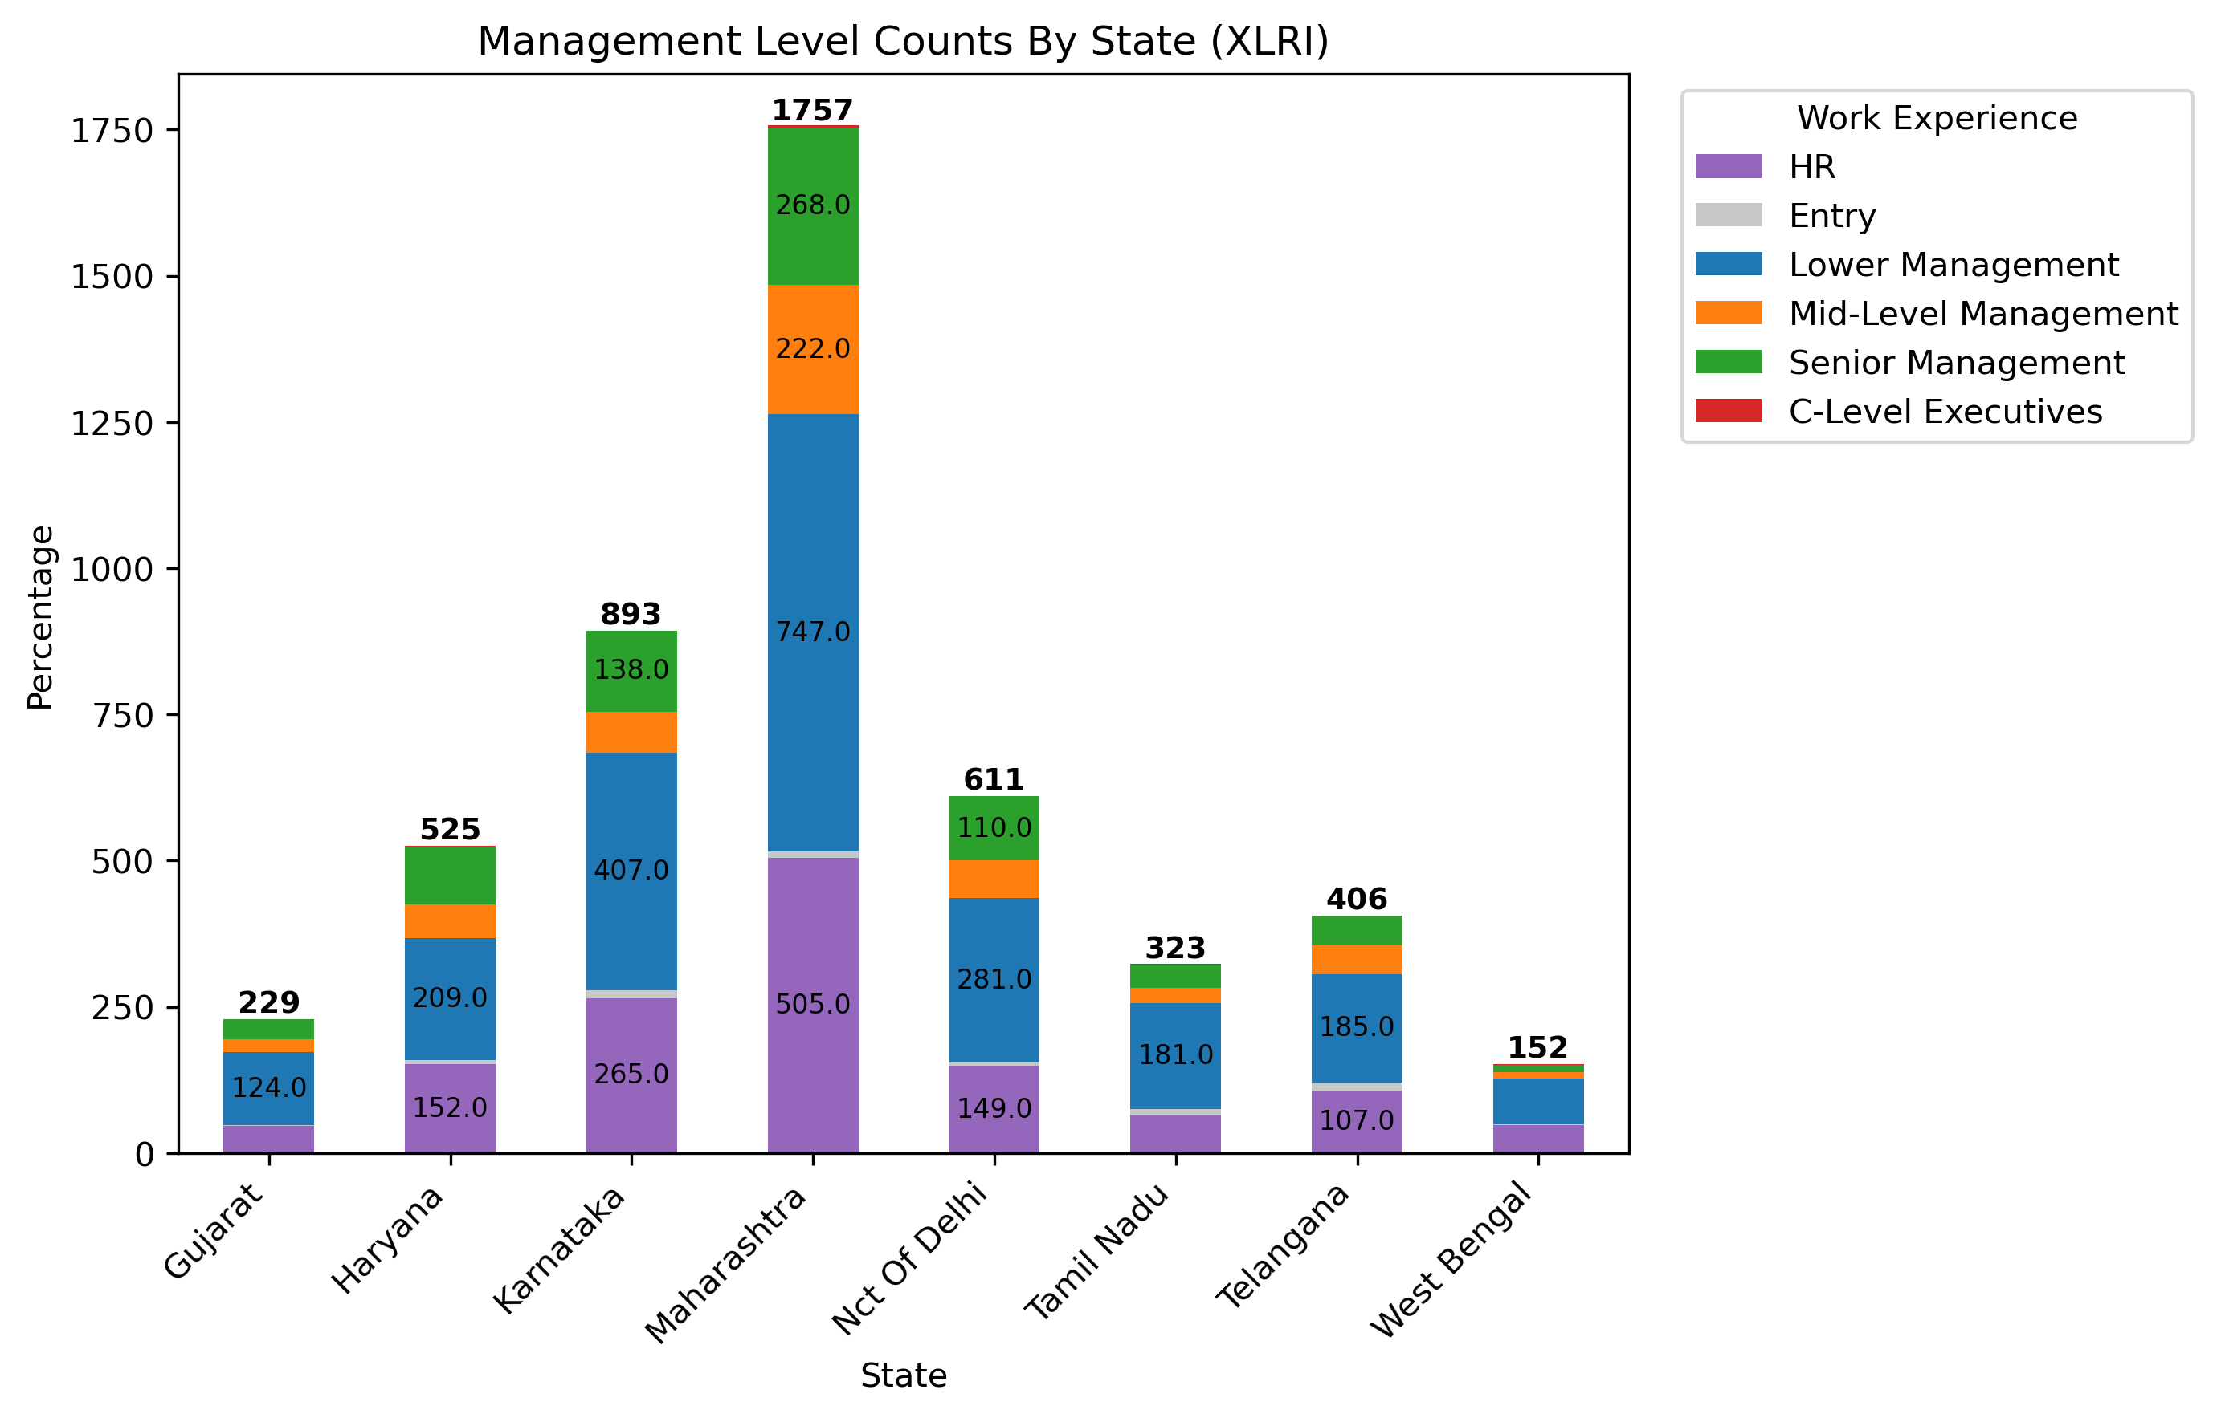

Slide 33
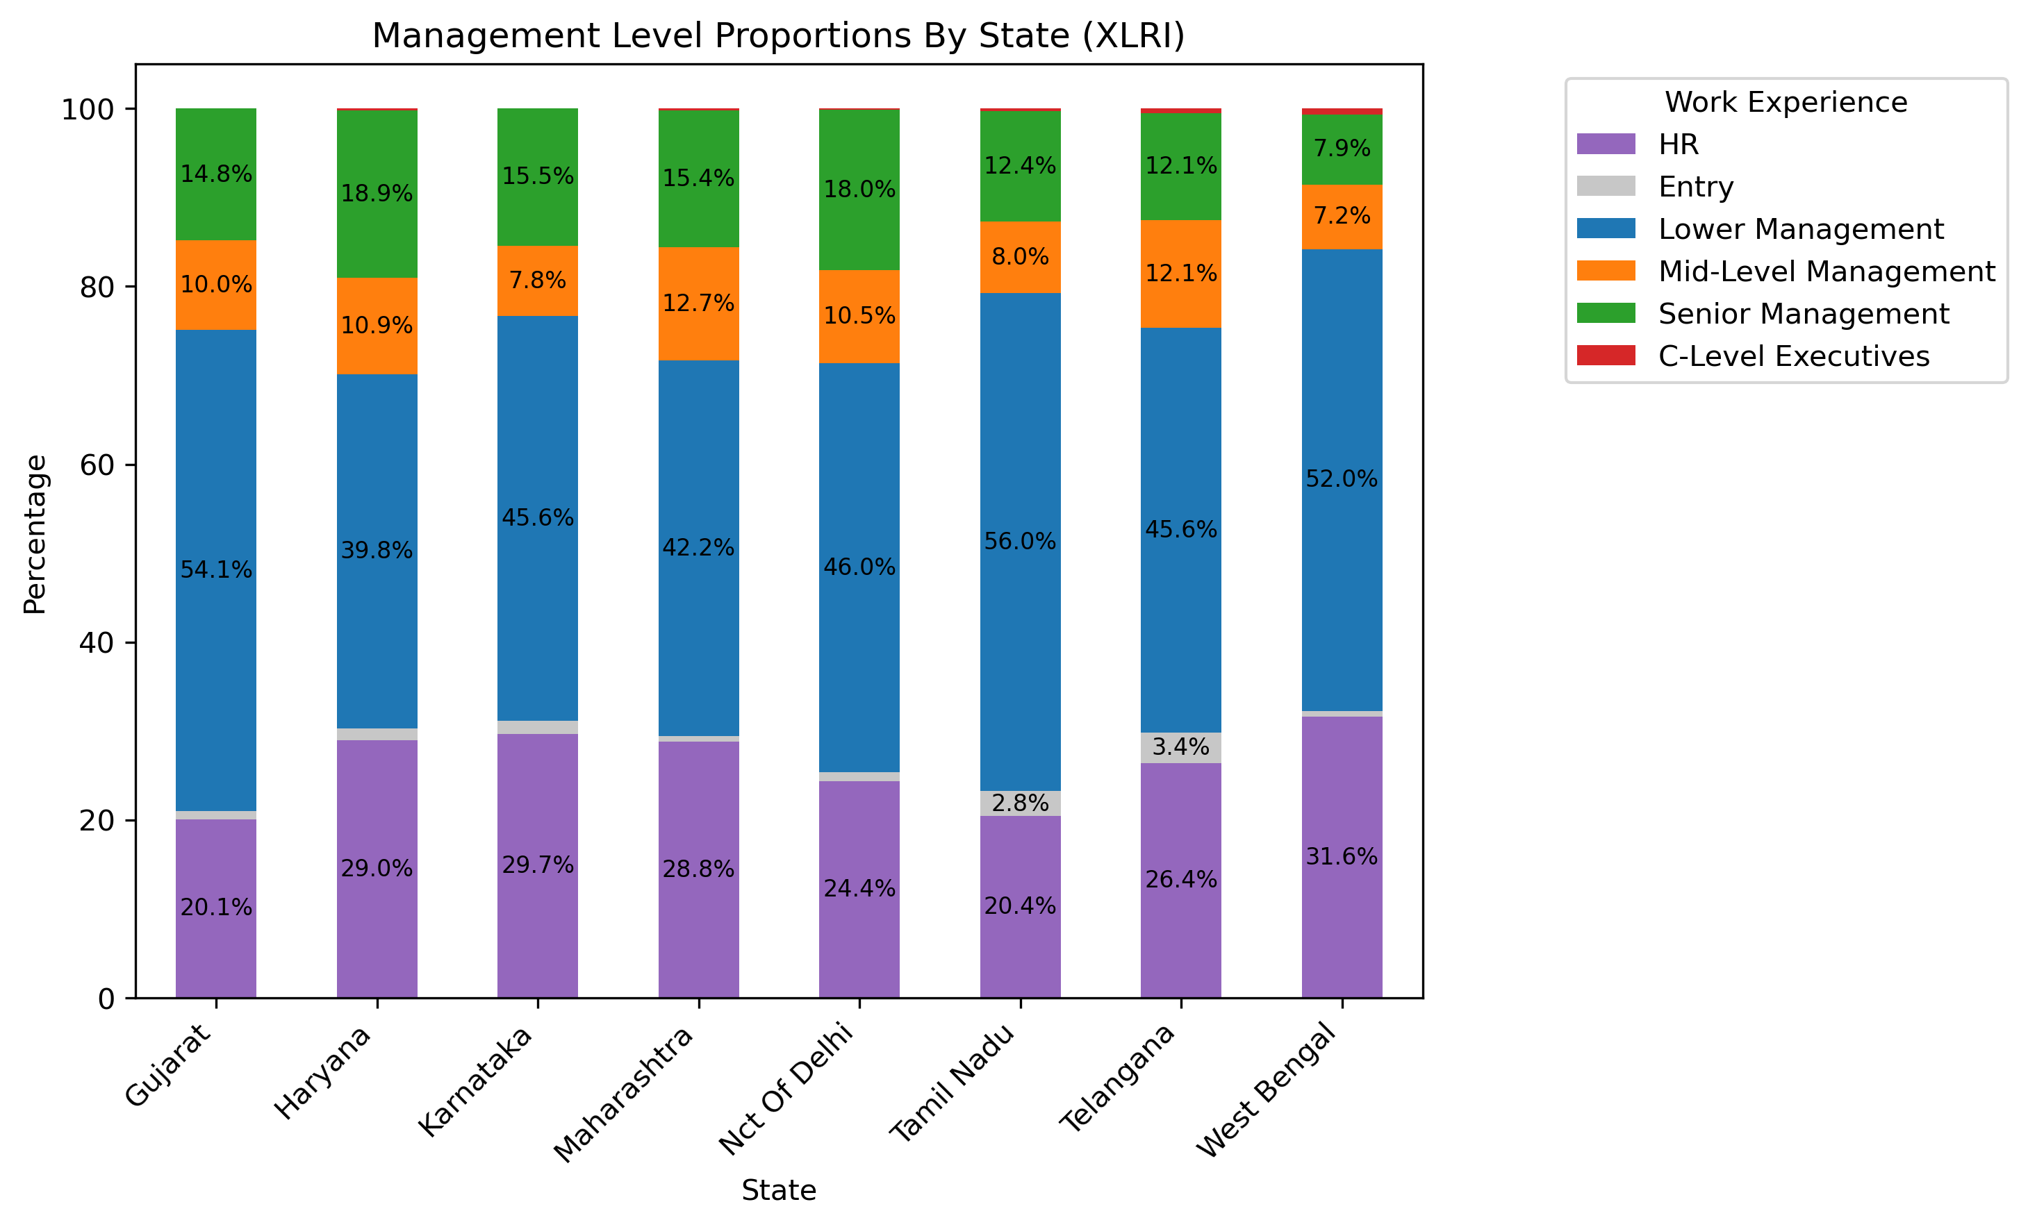
Notes:
Management level standardized job titles even further according to the legend
Majority of leads for each state come from Lower management with the second largest bucket coming from HR, then senior management which is a pattern for states
Management Buckets
HR
HR Business Partner
Assistant VP HR
Head HR
Head Talent Acquisition
Lead HR
HR Consultant
Senior Recruitment
Recruitment Head
Training Manager
Lead Talent Acquisition
Senior Talent Acquisition
Corporate HR
Lower Management
Manager
Senior Analyst
Assistant Manager
Associate Manager
Deputy Manager
Mid-Level Management
Assistant General Manager
Assistant VP
Associate VP
Senior Management
Associate Director
Director
Deputy General Manager
General Manager
VP
Global Head
Chief Manager
Global Lead
Senior VP
Senior Executive
Business Head
C-Level Executives
CEO
CXO
COO
CPO
Founder

Slide 34
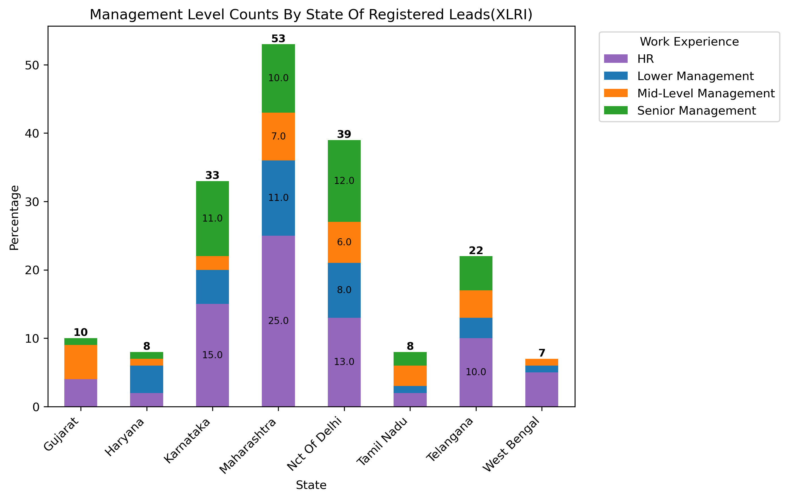

Slide 35
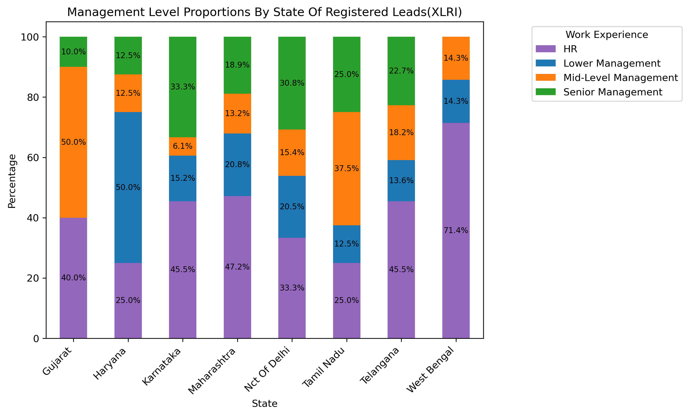
Notes:
- Looking at registered leads changes the proportions
Seemingly across nearly all of the sates, HR has the best conversion rate with certain exceptions
Gujarat and Tamil Nadu has Mid-Level management as it’s largest bucket
Haryana is once again an exception with lower management having it’s greatest conversion rate
Certain states such as Karnataka, Nct Of Delhi, Tamil Nadu, and Telangana have good senior management conversion rate all having above 20%

Slide 36
Country Data and Demographics
Notes:
- Country Data and Demographics

Slide 37
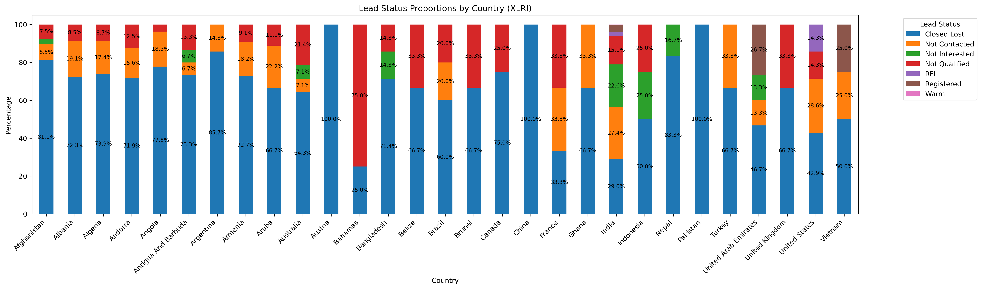
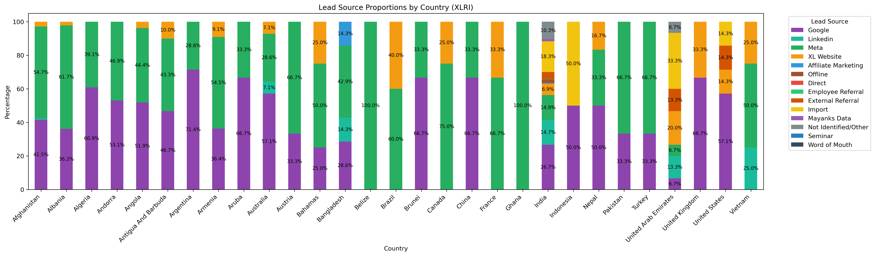
Notes:
Only includes countries with 4 or more entries
Only India, UAE, and Vietnam have any registers with more than 4 total entries

